Slide 1
Inside the World's Largest Python Course on Coursera
Dr. Charles Severance
University of Michigan School of Information

Slide 2
TL;DR;
I am obsessed with advancing Educational Technology and using that technology to teach programming to everyone regardless of background or barriers. Also Open Source and Open Educational Resources.

Slide 3
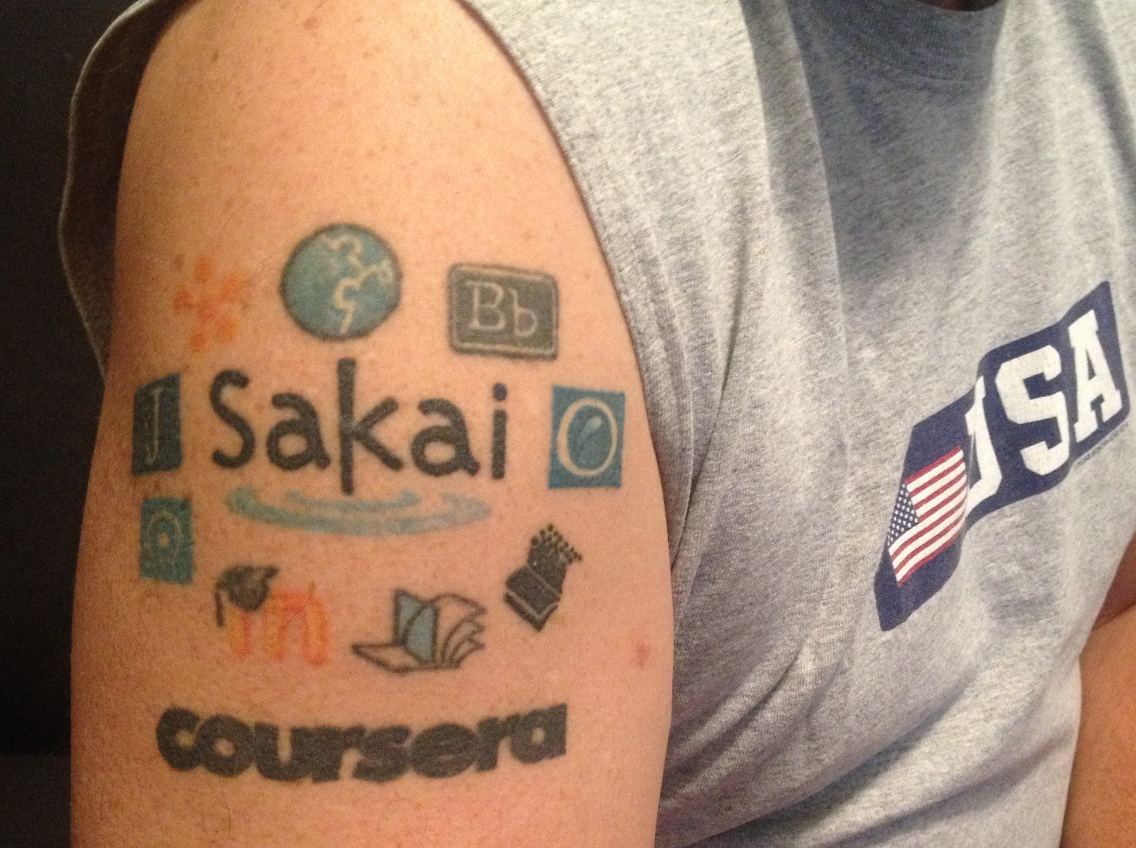
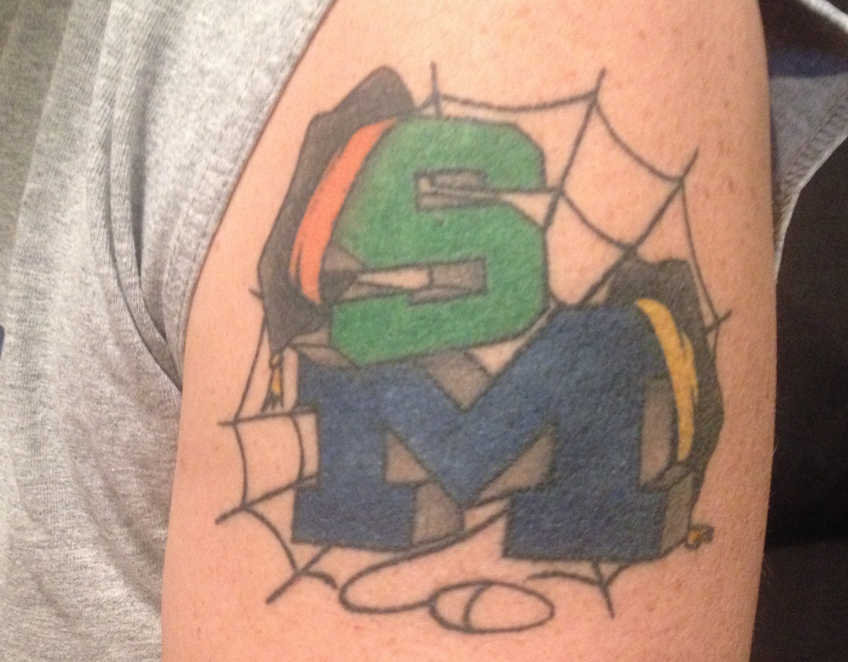

Slide 4
What is a MOOC?
Circa 2012: Massively, Open, Online, Course
Circa 2018
Scalable from 500 to 100K+ students without greatly increasing costs
Open Admission – Might charge fee of less than $100
Online
Four week unit (about 1 credit)
Providers
www.coursera.org
www.edx.org
www.futurelearn.org
www.udacity.com
www.udemy.com

Slide 5
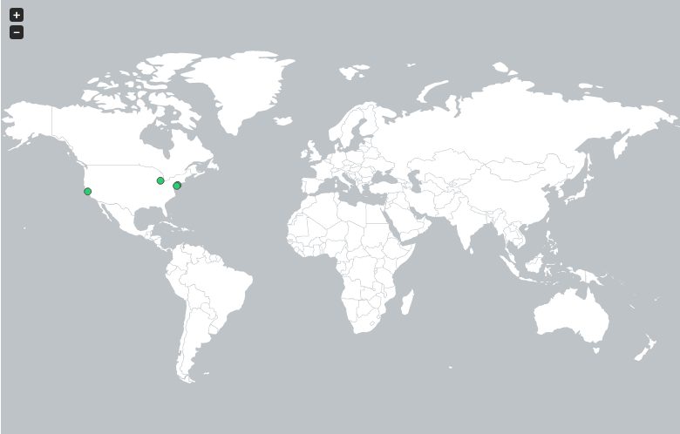
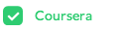
http://edutechnica.com/moocmap/
April 2012
Notes:
But let me take you back 18 short months when there was only one provider of MOOCs with only four Universities (University of Pennsylvania, Stanford, Michigan, and Princeton). It was just an experiment in early 2012 and I was fortunate to even know about the emerging effort – let alone be given a chance to teach this new type of course for the University of Michigan.

Slide 6
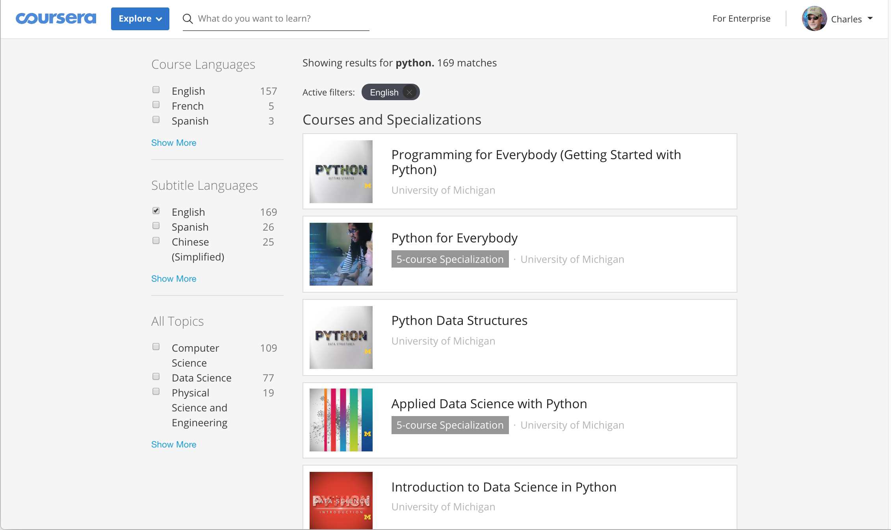

Slide 7
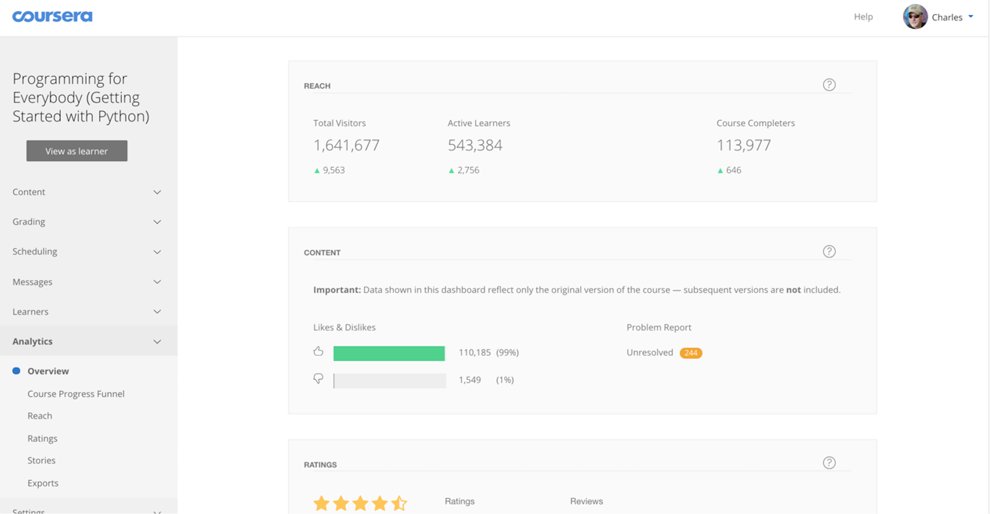
Plus 550K students from an earlier Python 2 MOOC.

Slide 8
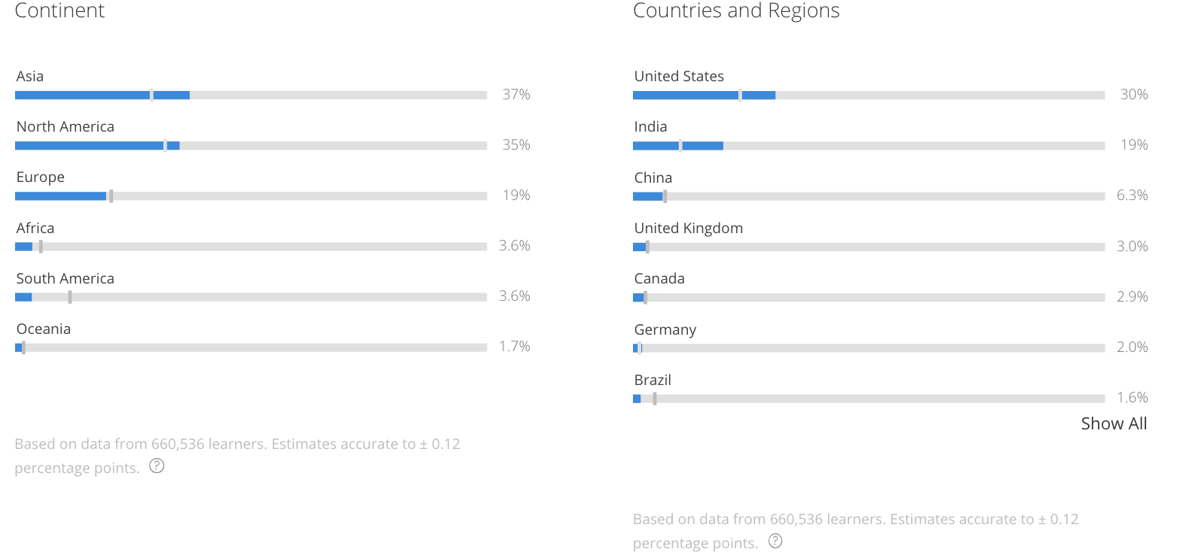

Slide 9
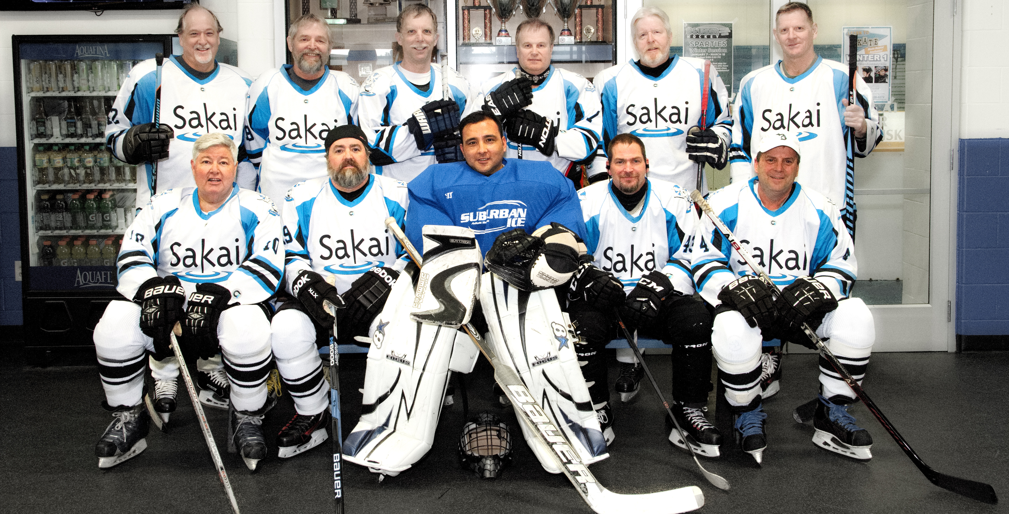

Slide 10
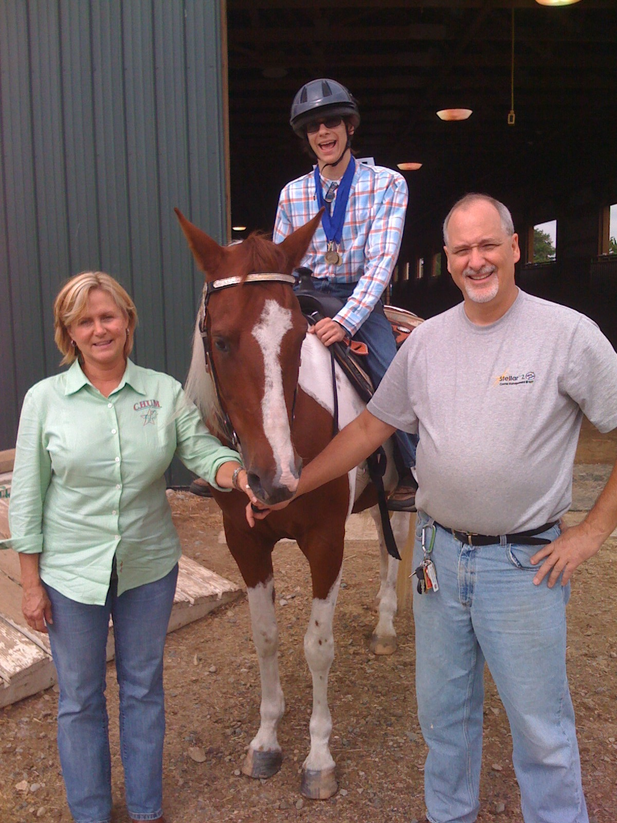

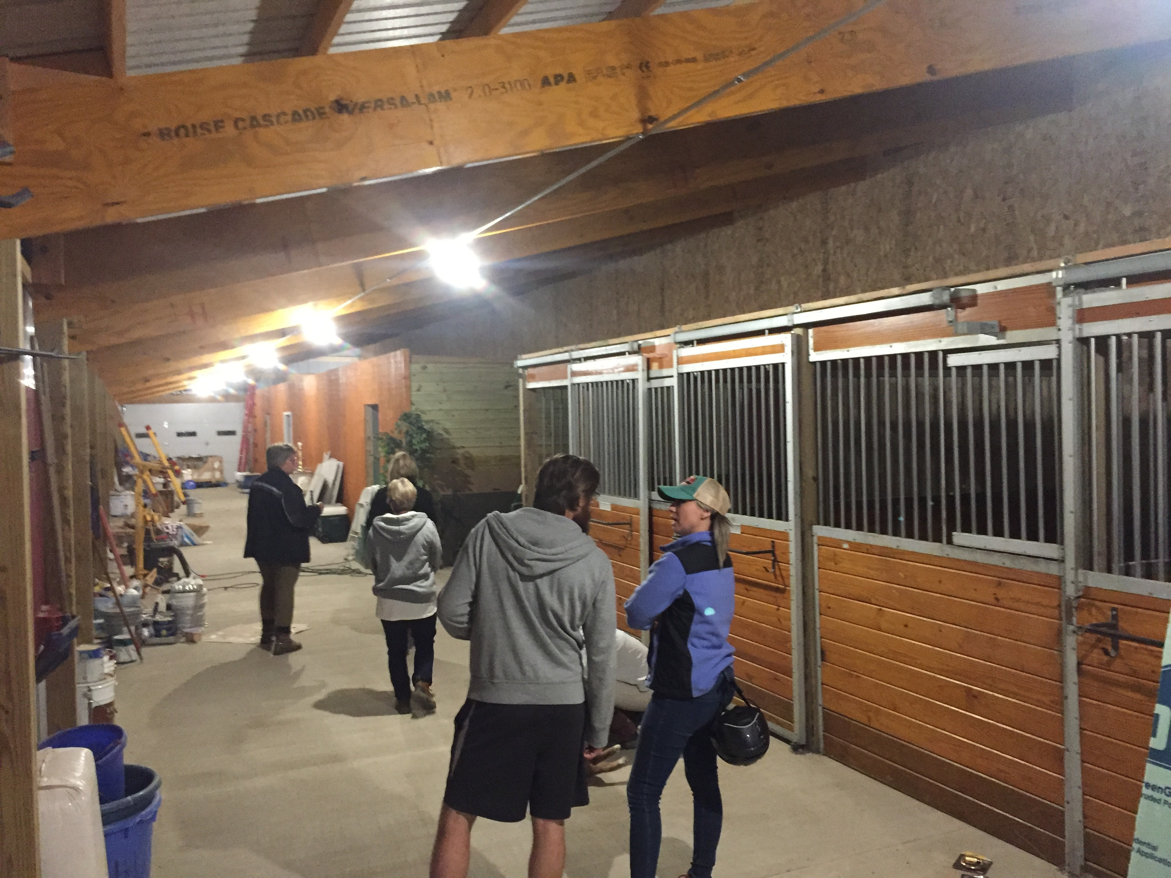


Slide 11
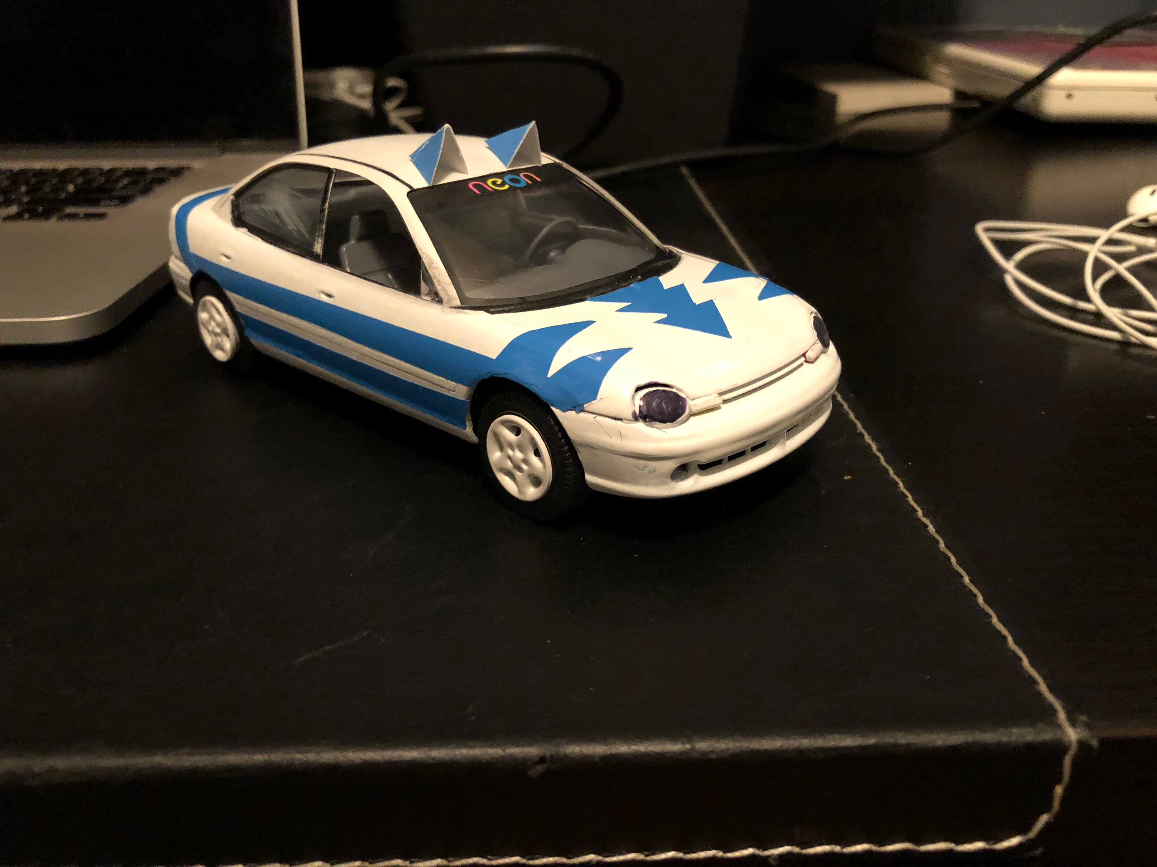


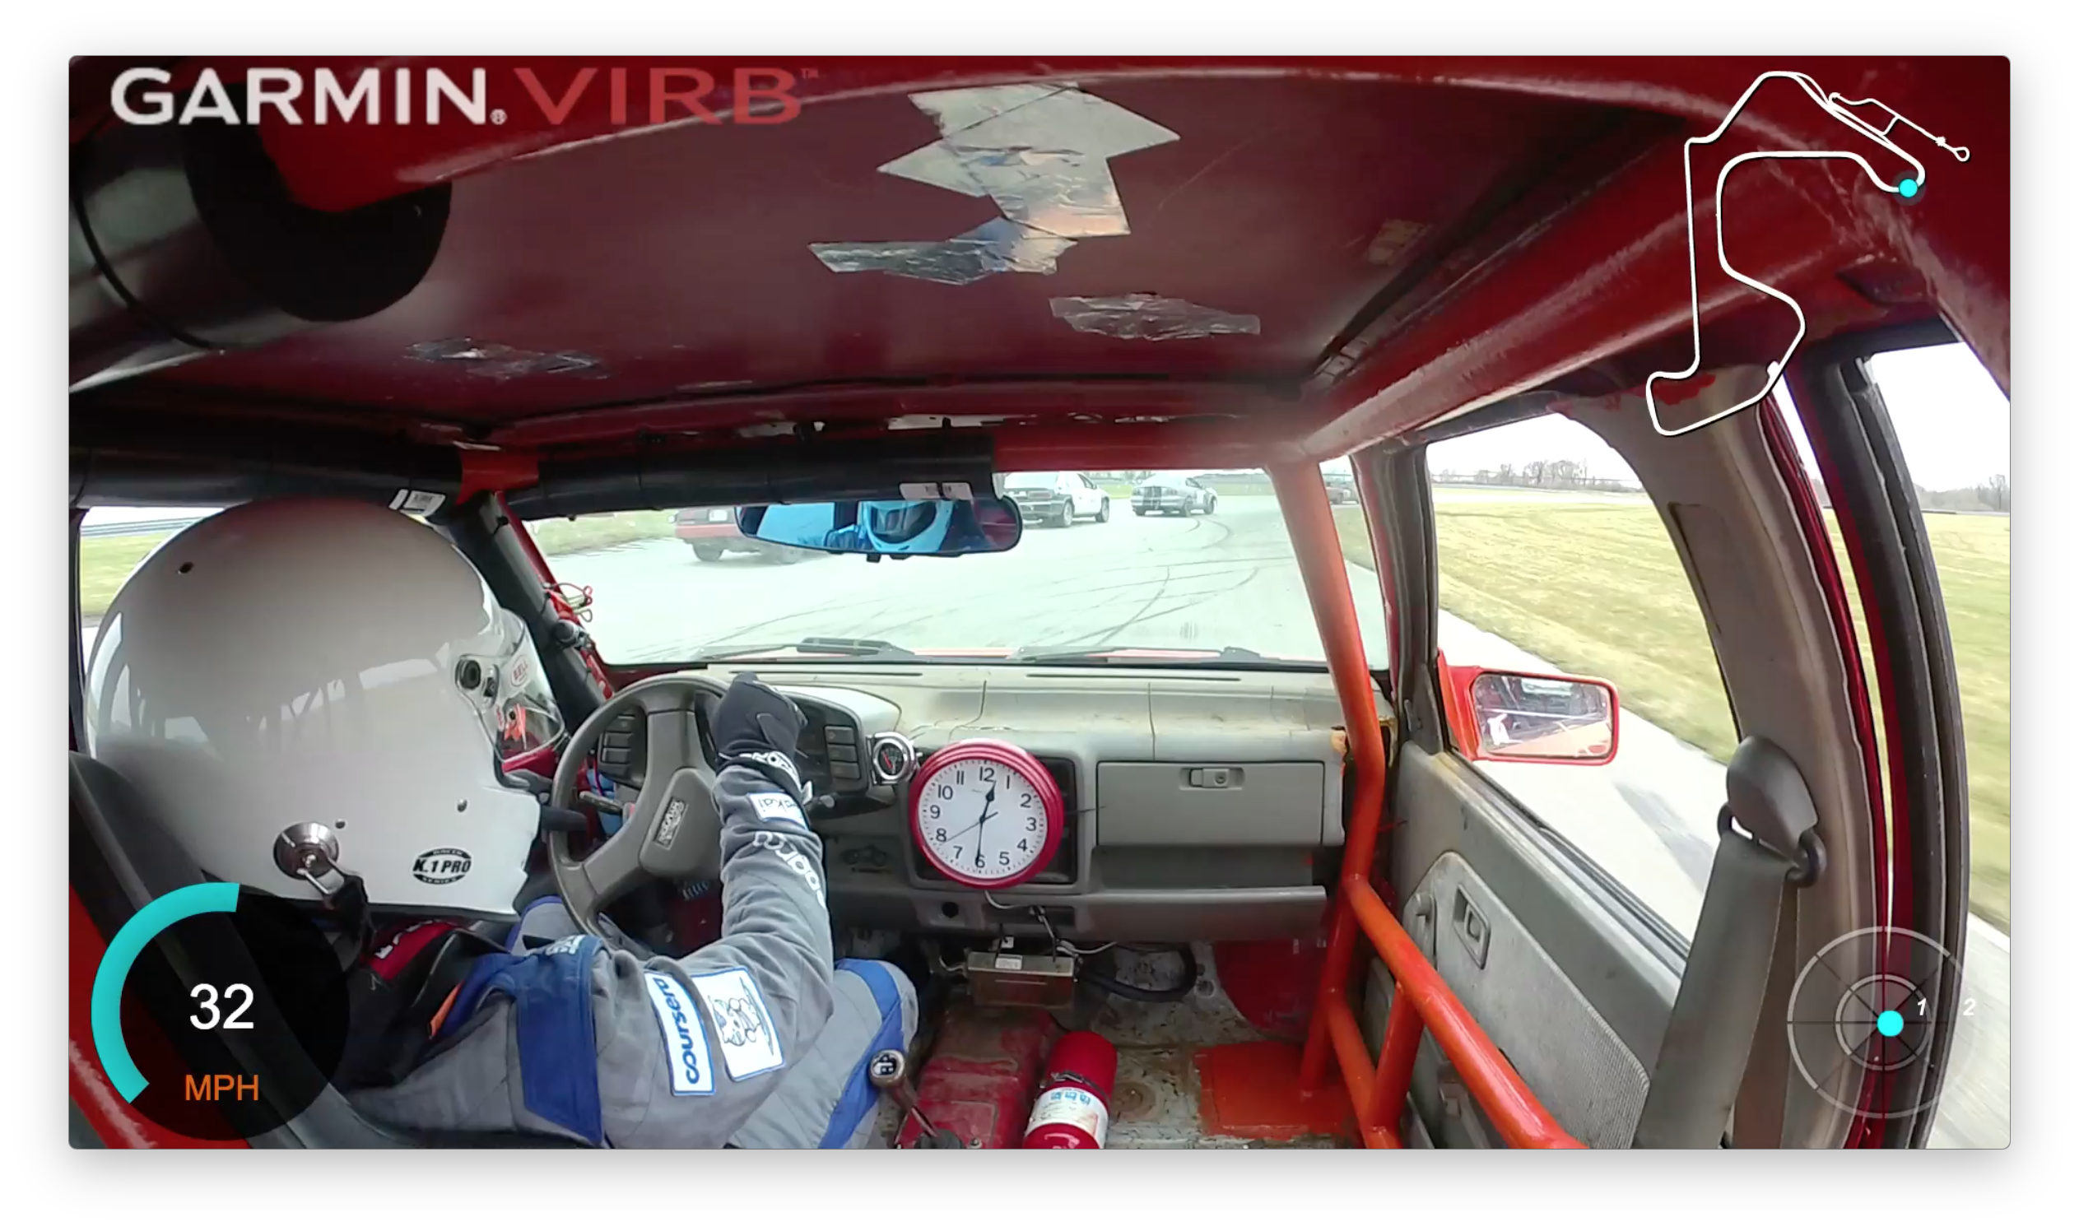
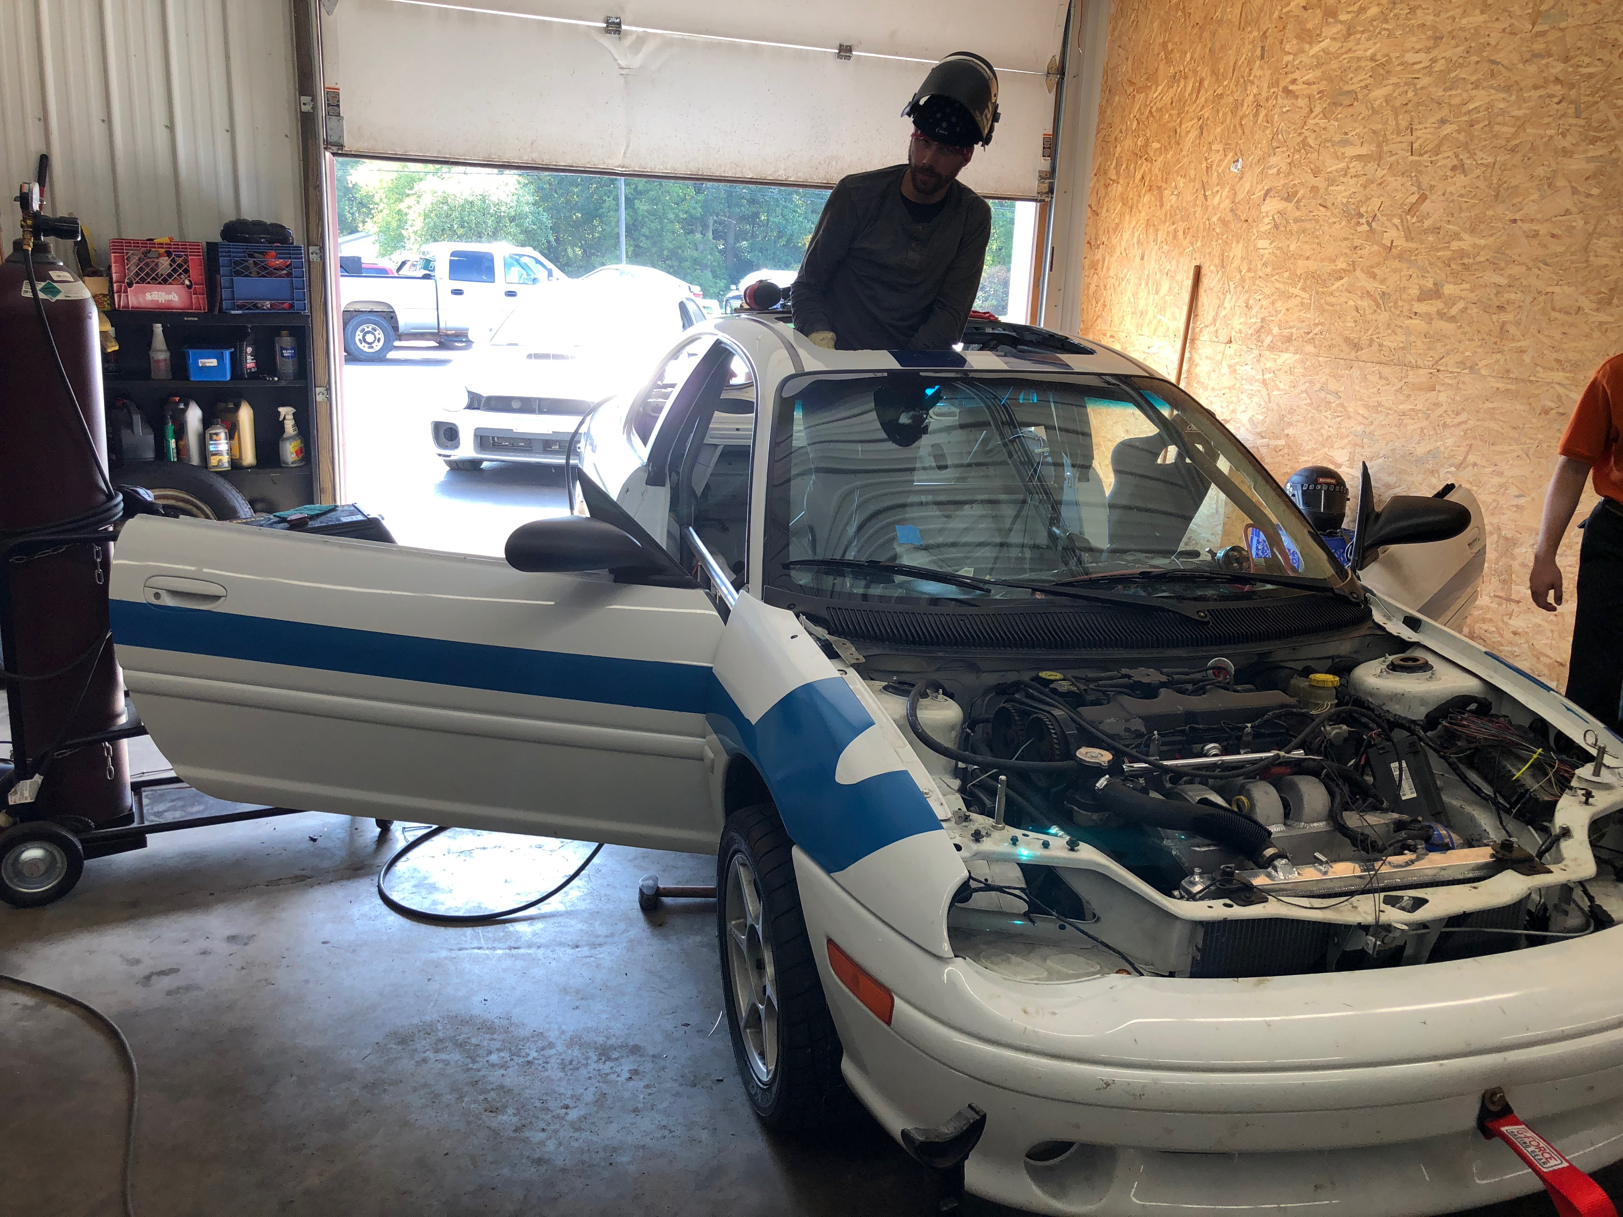

www.twitter.com/sakaicar
www.sakaiger.com
www.24hoursoflemons.com

Slide 12
My Research: Educational Technology

Slide 13
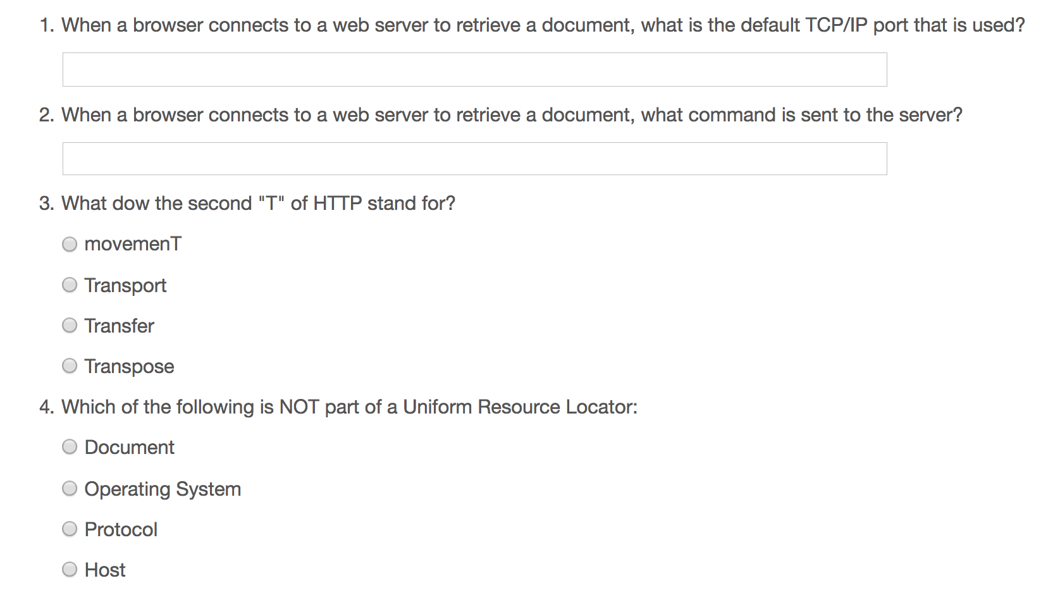
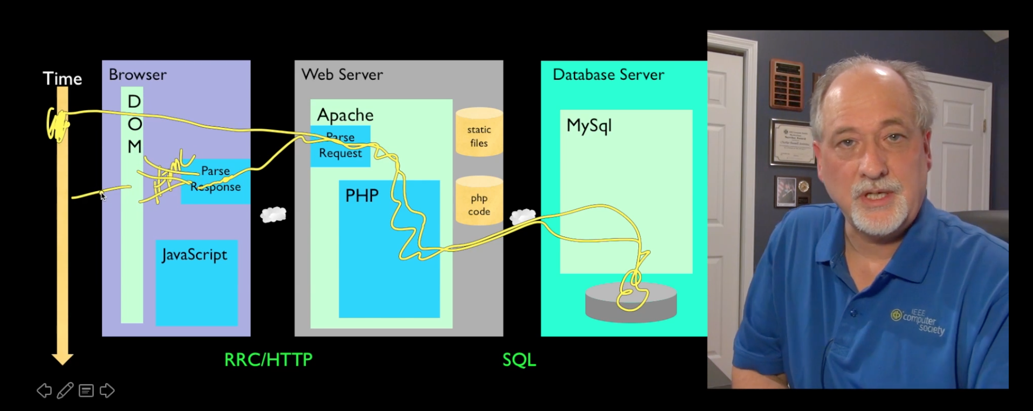
A Typical Scalable Online Class
Record Lectures
Build quizzes
Maybe use peer grading

Slide 14
My Path to a Scalable Online Course
Build Lecture Capture software (Sync-O-Matic) 1997
Build Lecture Capture Software (Clipboard-2000) 2001
Build an open source Learning Management System (LMS) (Sakai) (2004)
Build a standard for LMS interoperability / convince the mainstream systems to implement (2008)
Write a free textbook / upgrade that textbook / translate the textbook (2008)
Build open source software framework to build learning tools (Tsugi) (2011)
Build clever / puzzle based assessment software in the framework (2012)
Integrate those assessments in on campus courses
Build my own social / peer graded assessment software (2013)
Help Coursera write code to integrate my assessments (2014)
Build an open source small, standalone MOOC Platform to host those tools (Koseu) (2016)
Release all materials for free under Creative Commons / Apache (www.py4e.com)
Record lectures
Build courses with quizzes + engaging assessments
Build a learning community and mentor / empower / support its leaders
Turn the course into a "television" show / YouTube channel

Slide 15
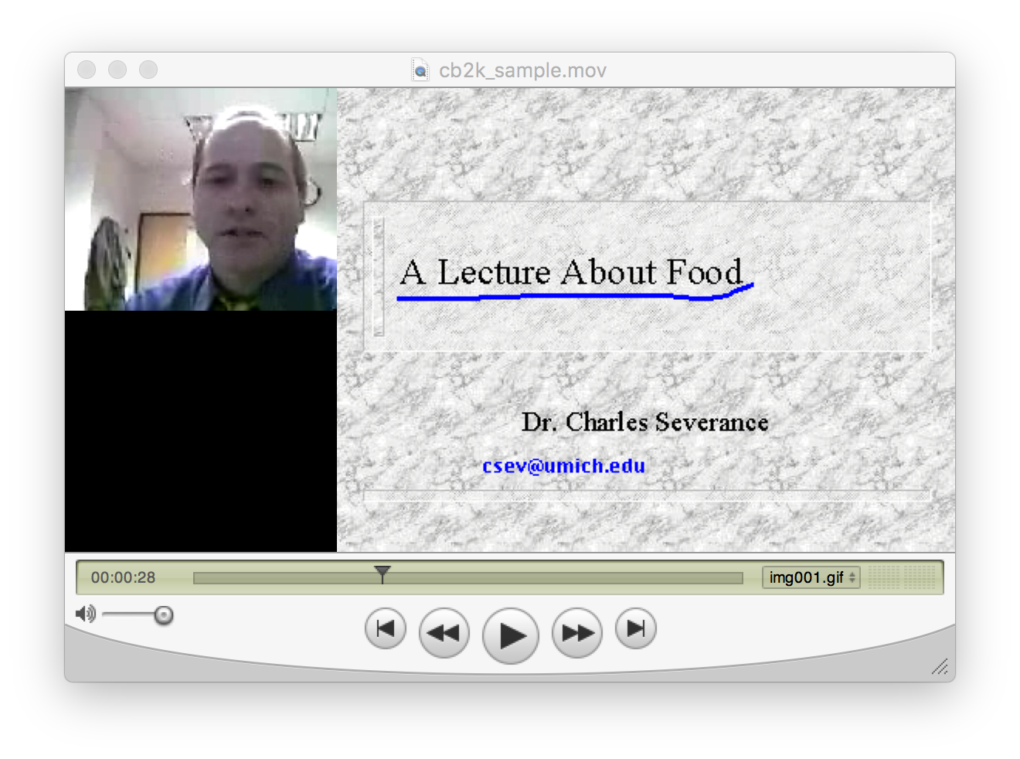
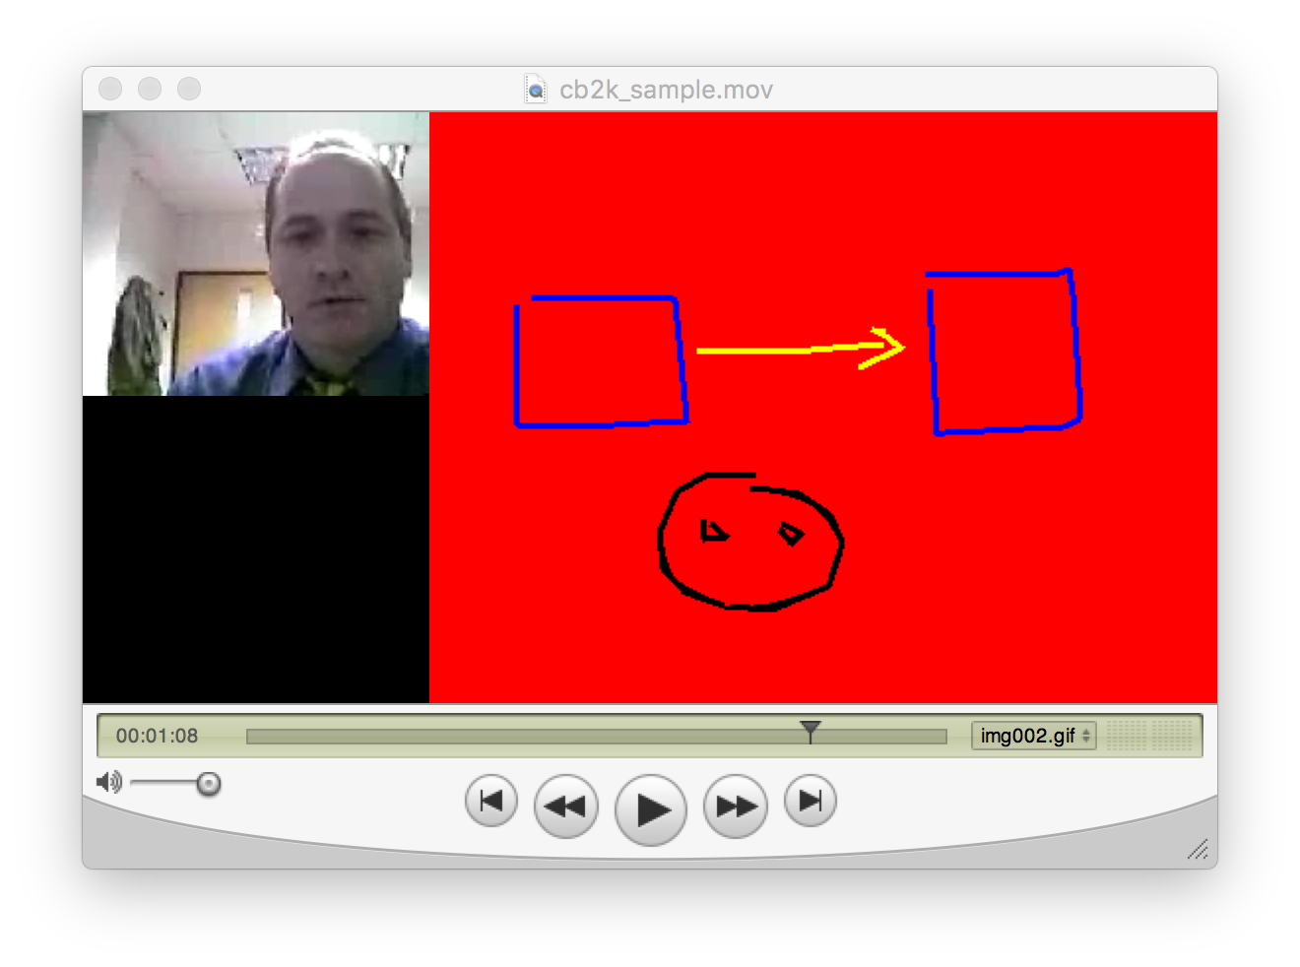
Clipboard-2000

Slide 16
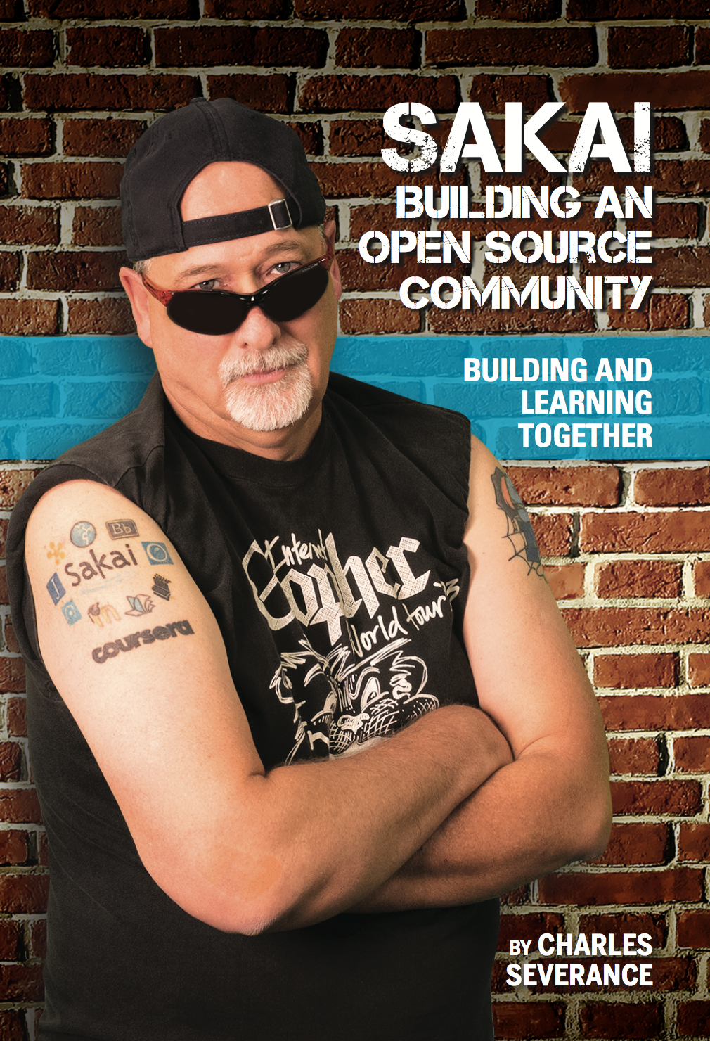
2002 - present
www.sakaiproject.org
www.dr-chuck.com/sakai-book

Slide 17
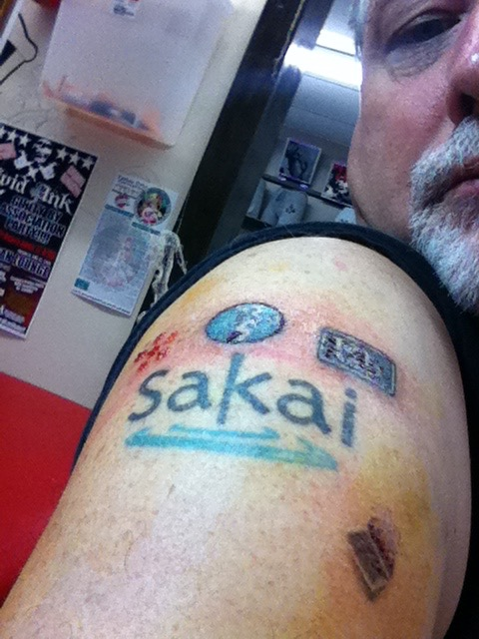
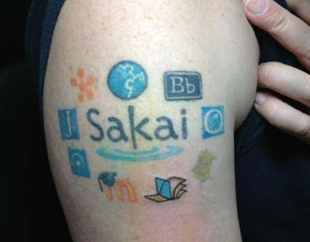
IMS Learning Tools
Interoperability (LTI)
2008-2013

Slide 18

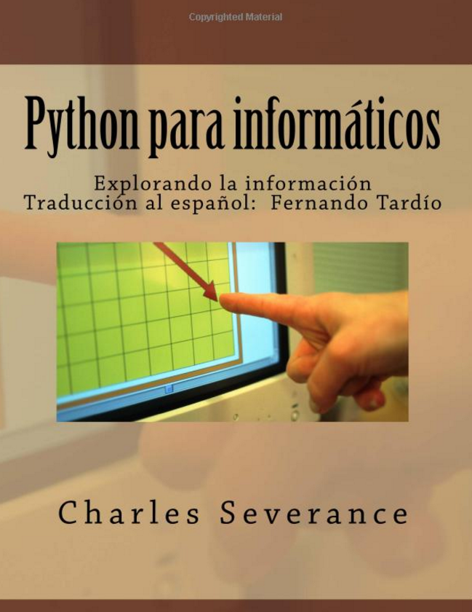
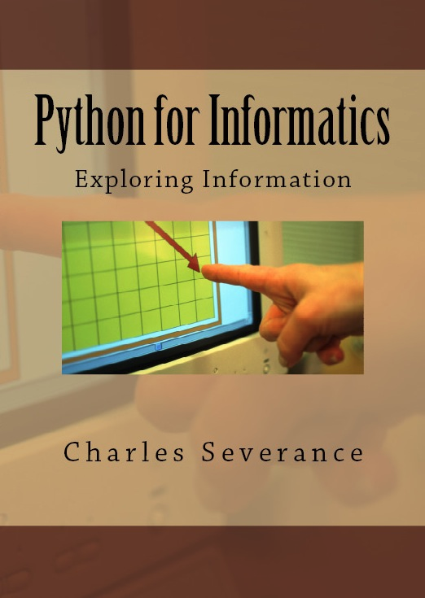
2008 - present

Slide 19
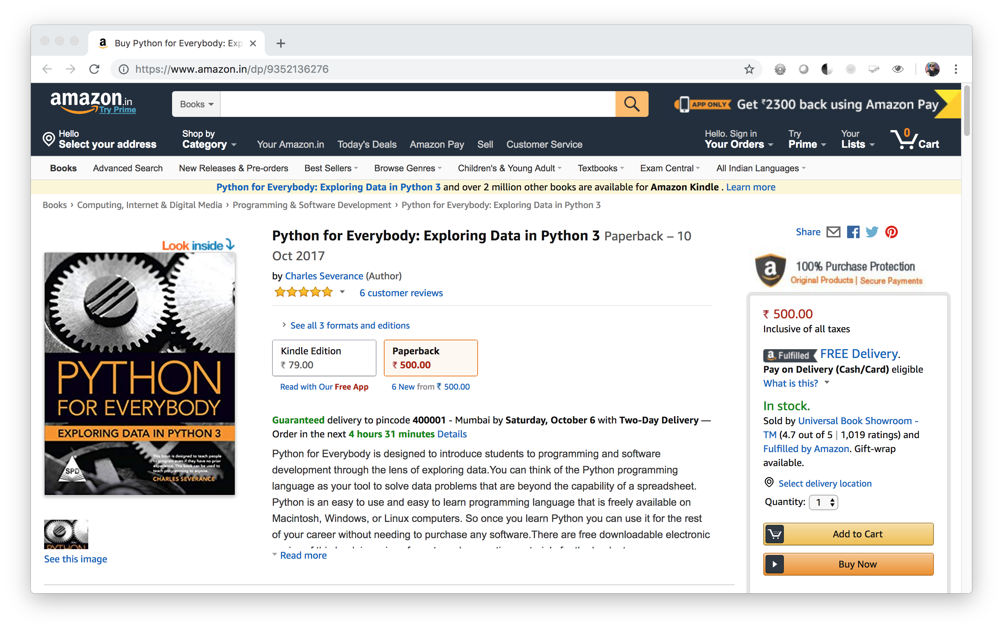

Slide 20
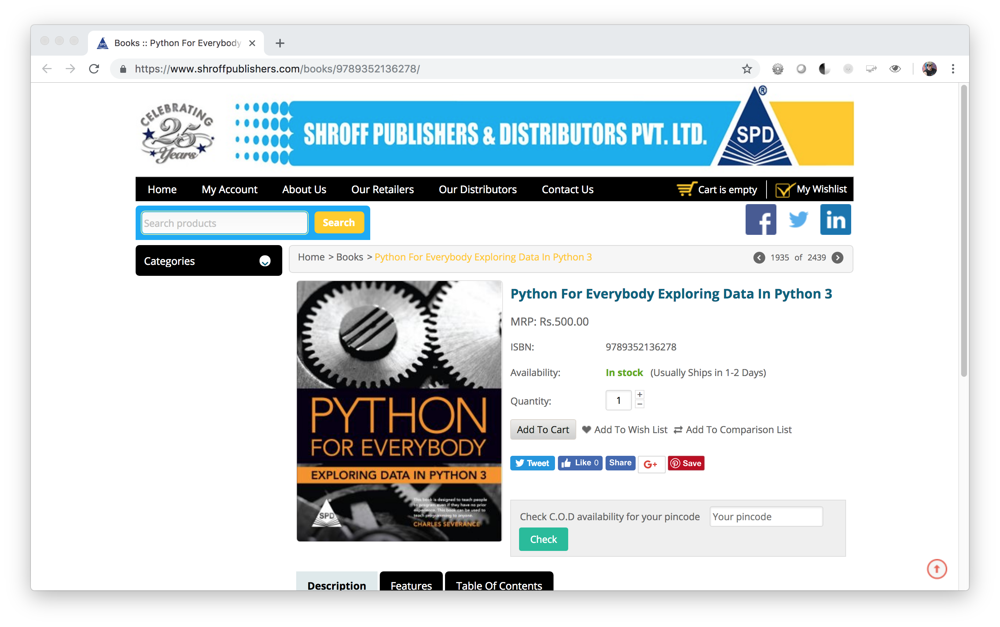

Slide 21
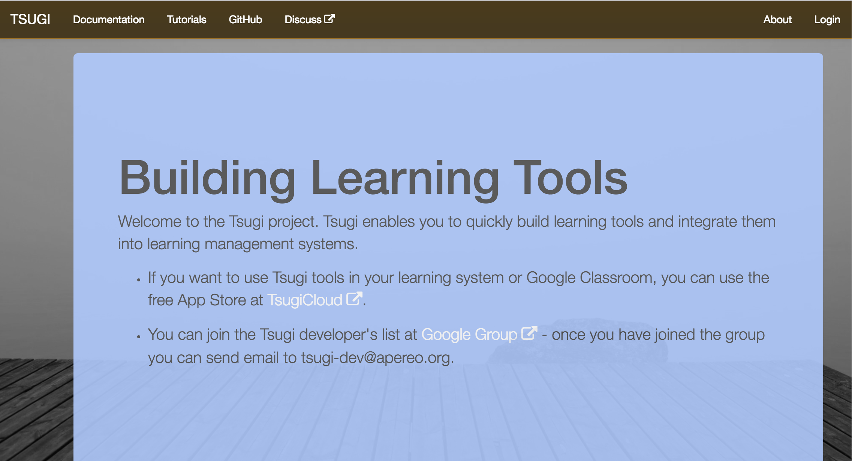
2013 - Present

Slide 22
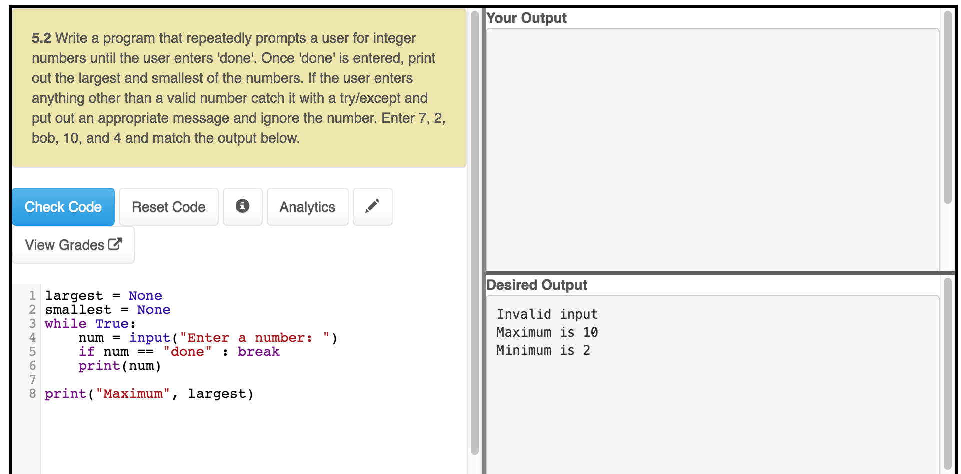
www.py4e.com

Slide 23
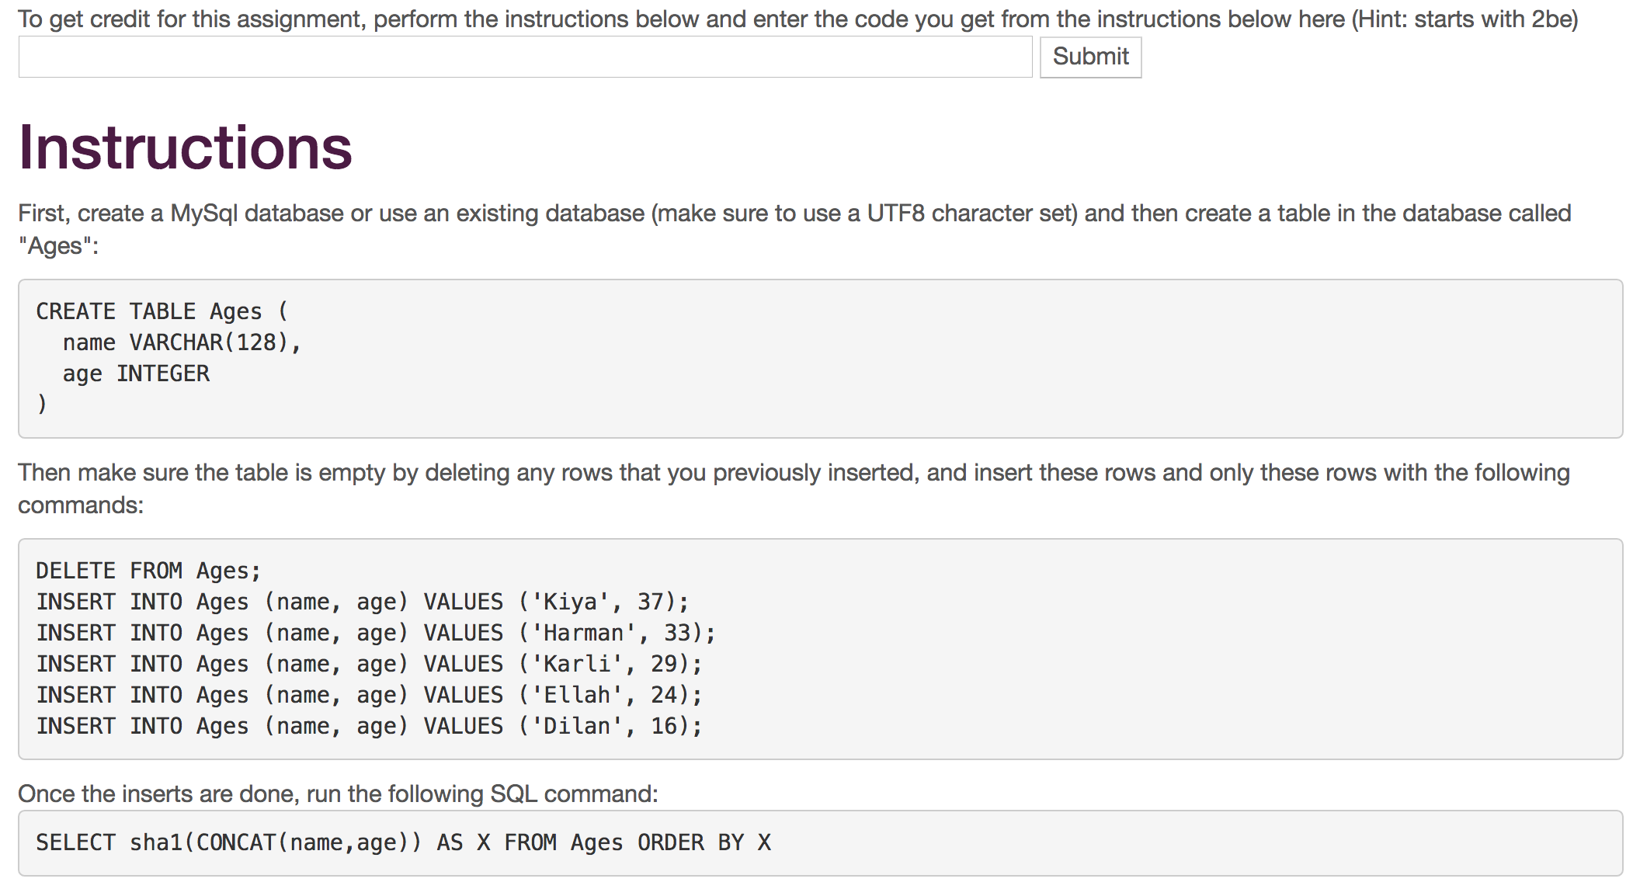
www.wa4e.com

Slide 24
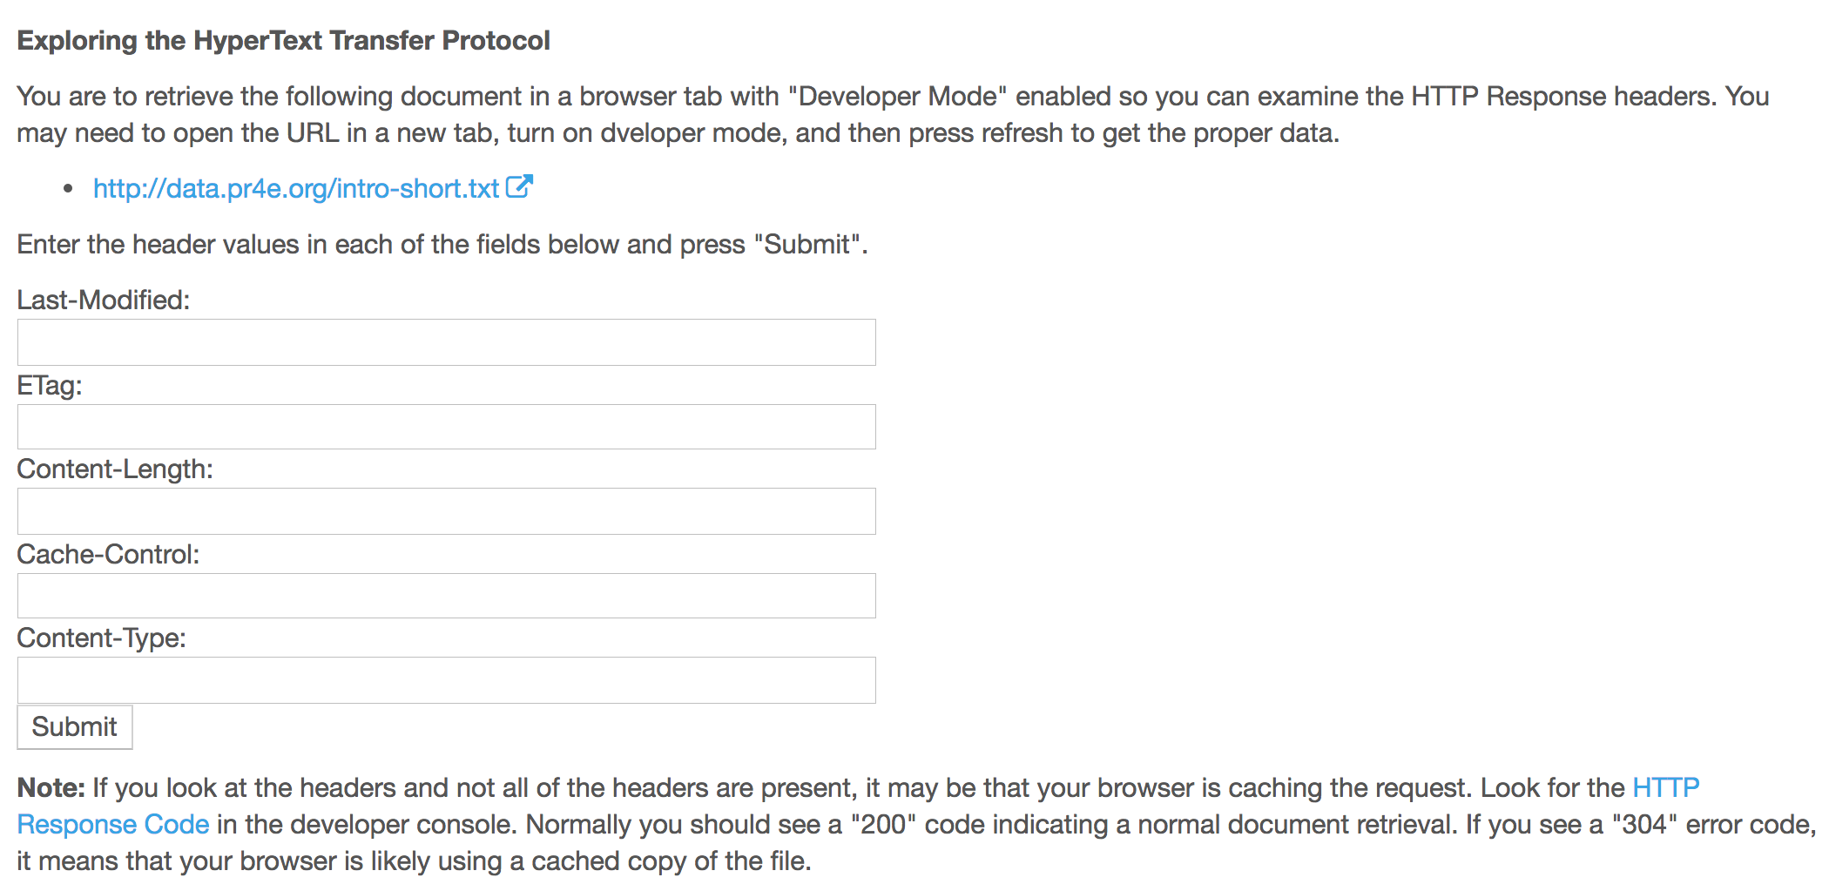
www.wa4e.com

Slide 25
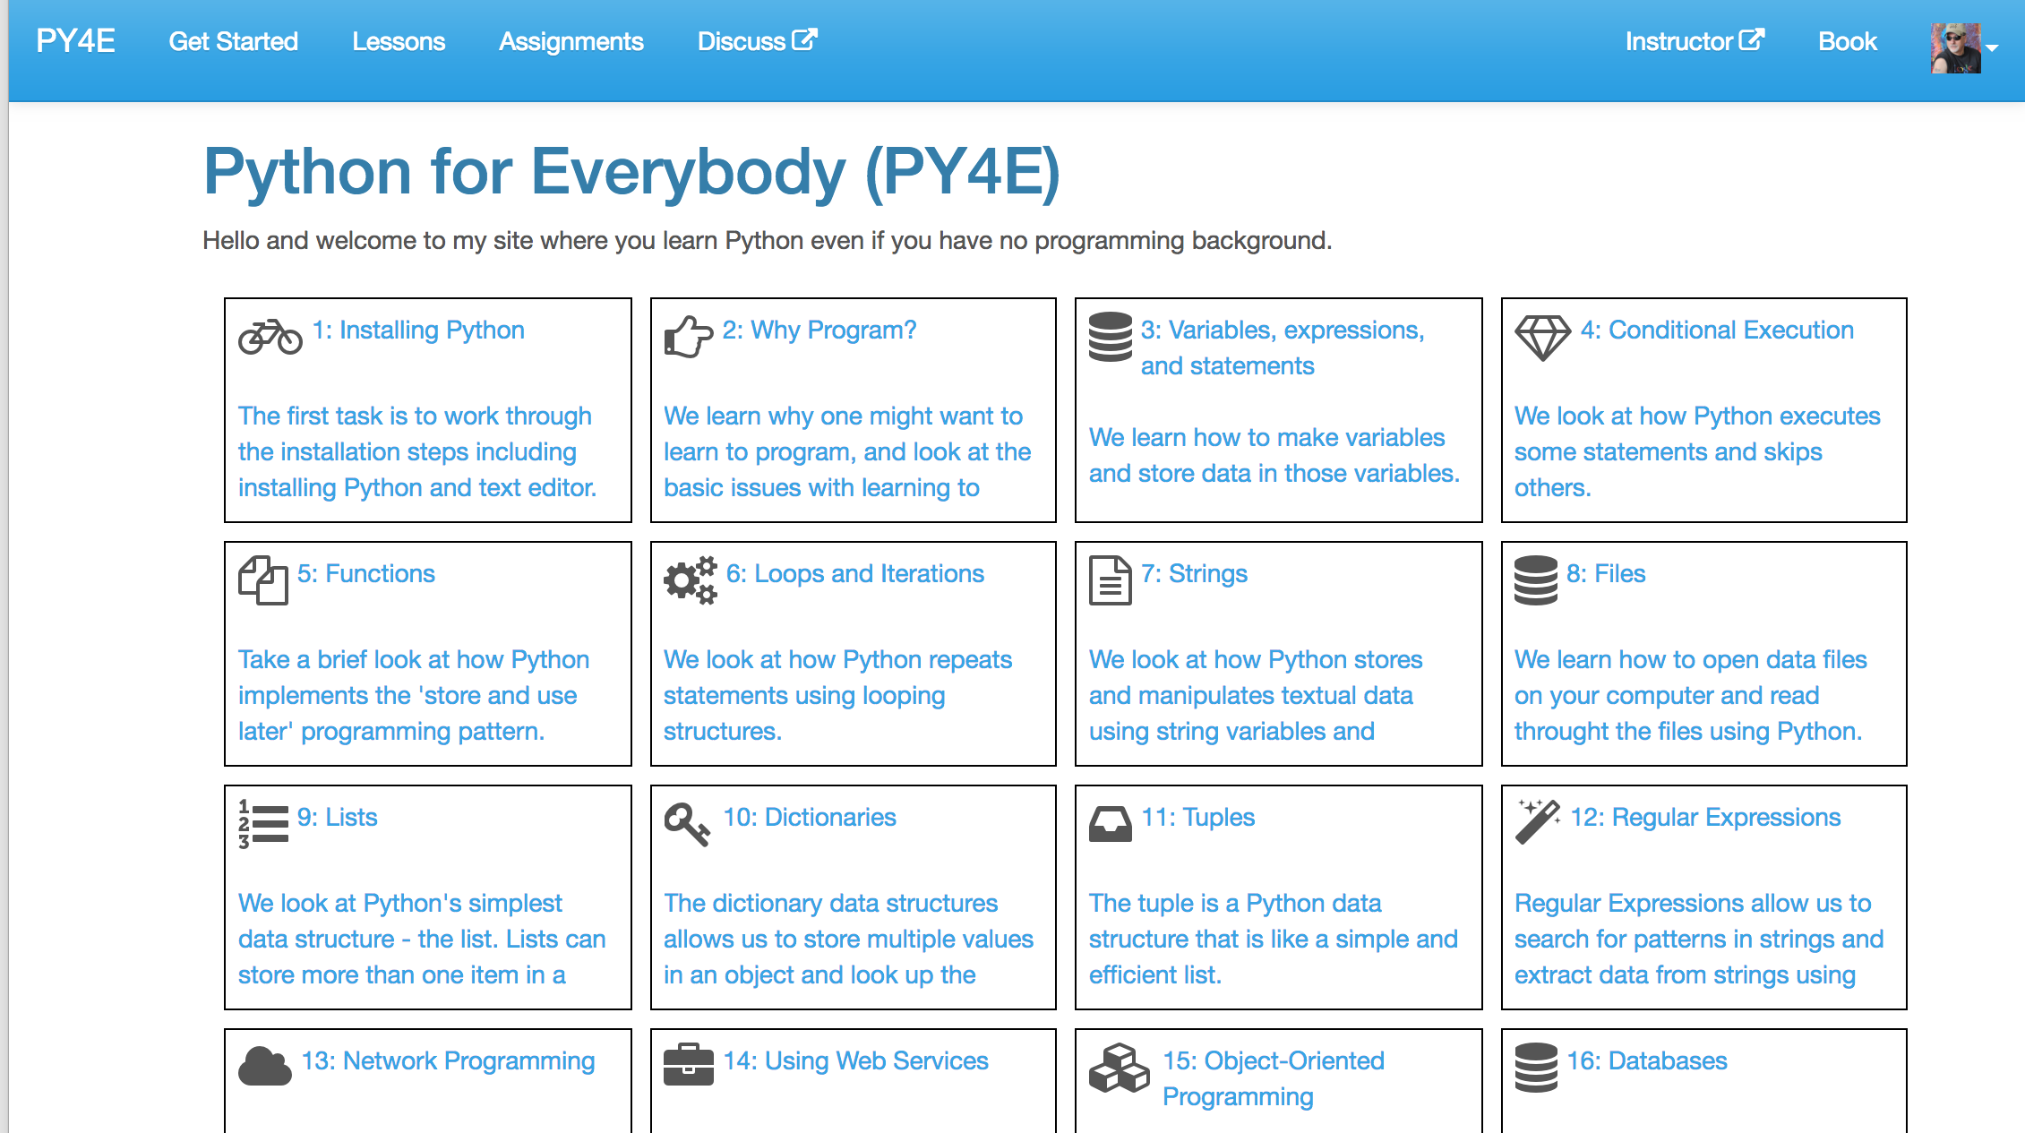
www.py4e.com

Slide 26
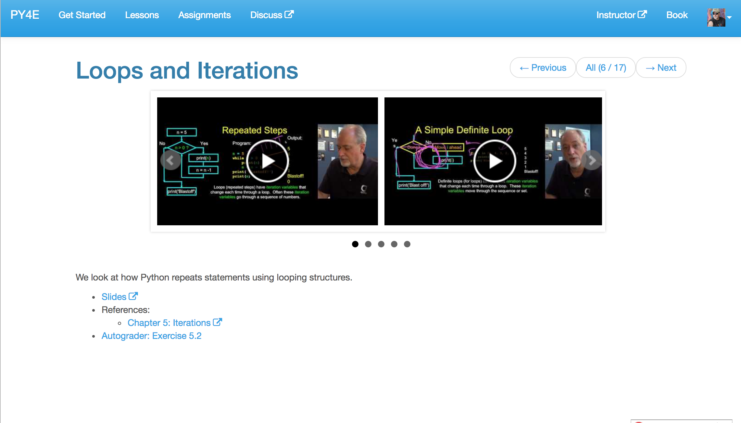
www.py4e.com

Slide 27
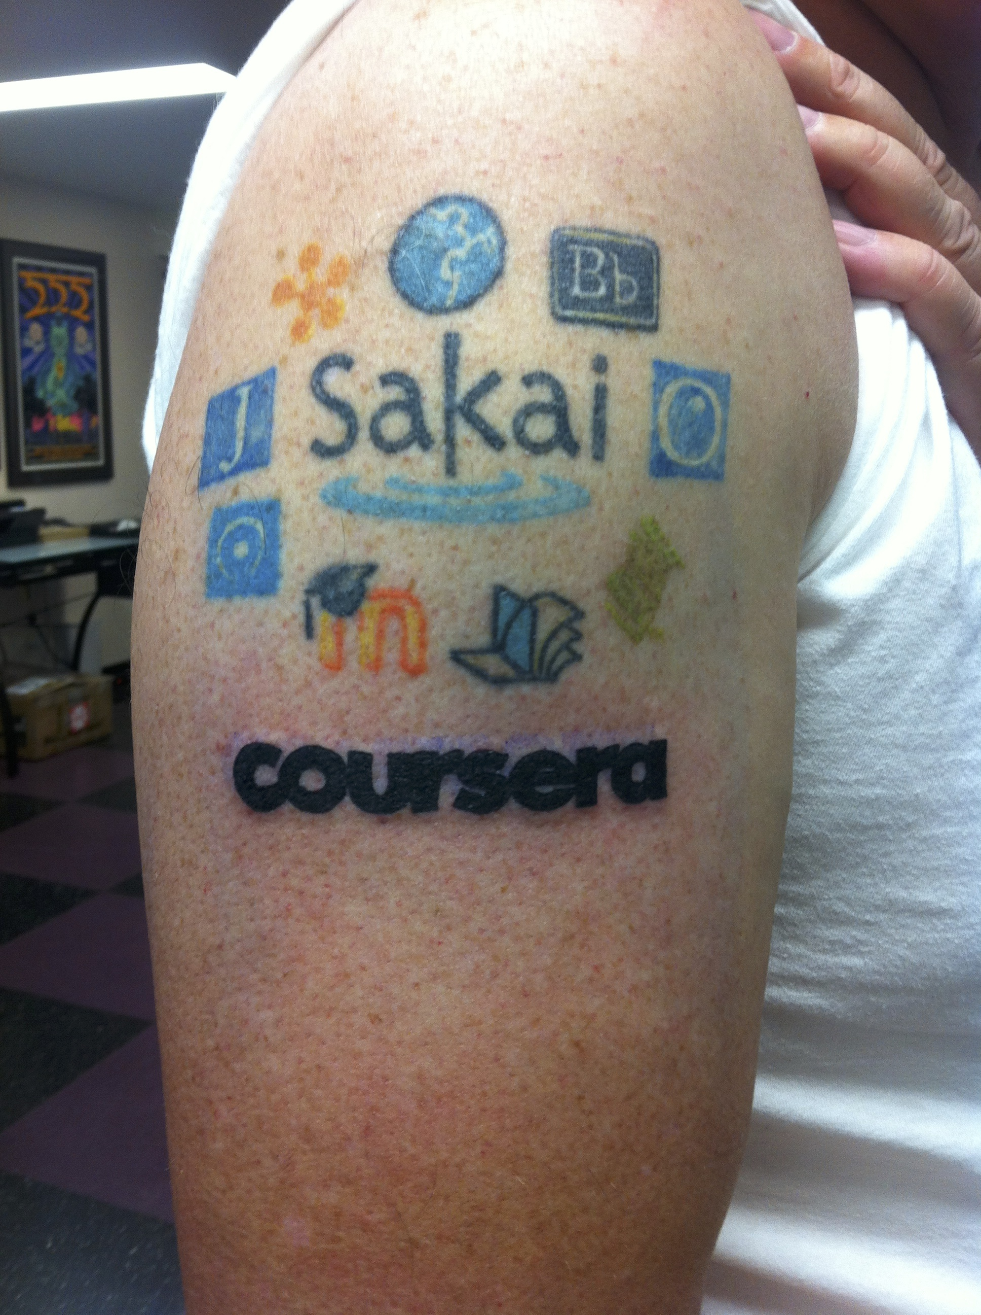
November 2013, I spent two days at Coursera in Mountain View and help them code Learning Tools Interoperability into the product.
That same night, in Redwood City, I added Coursera to my Tattoo.

Slide 28
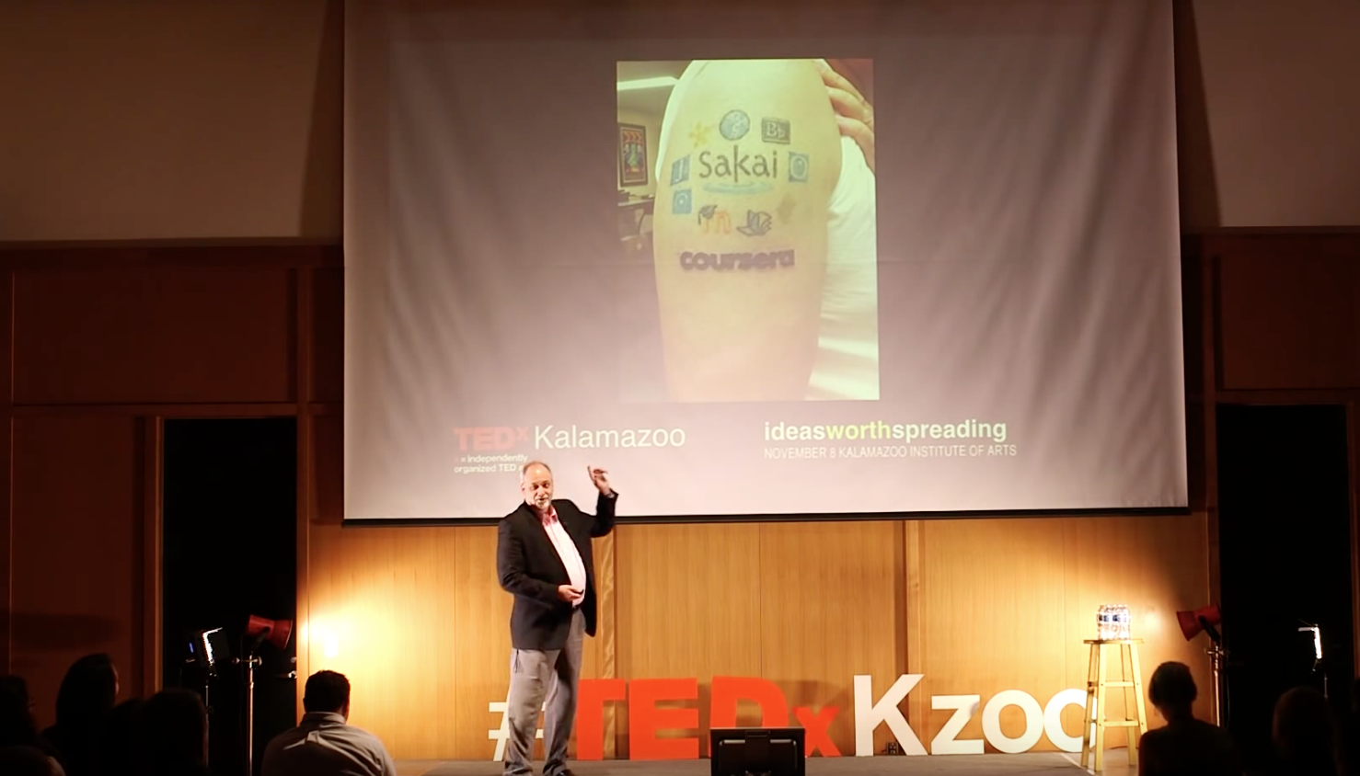
I fly back to Michigan the next day and give a TEDx talk in Kalamazoo.
https://www.youtube.com/watch?v=slscHD40r78

Slide 29
Building Coursera Courses So Far…
Specializations
Python for Everybody (2015)
Web Applications for Everybody (SQL / PHP / JavaScript) (2017)
Courses
Internet History, Technology, and Security (2012)
Python (5)
Web Applications (4)
Teachout (www.teachout.org)
Internet and You with Doug van Houweling (2017)

Slide 30
Not just Technology…

Slide 31
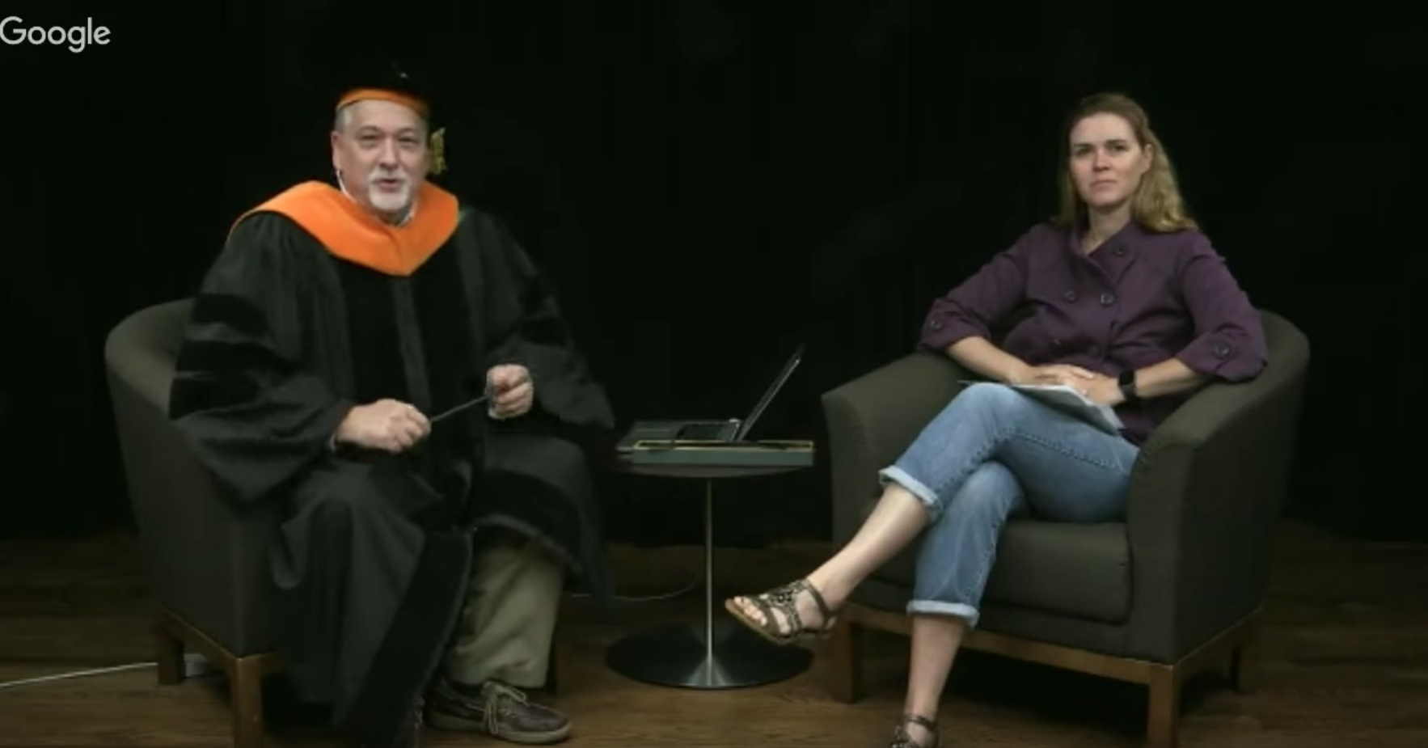
https://www.youtube.com/watch?v=T5N7yxKFn9g

Slide 32
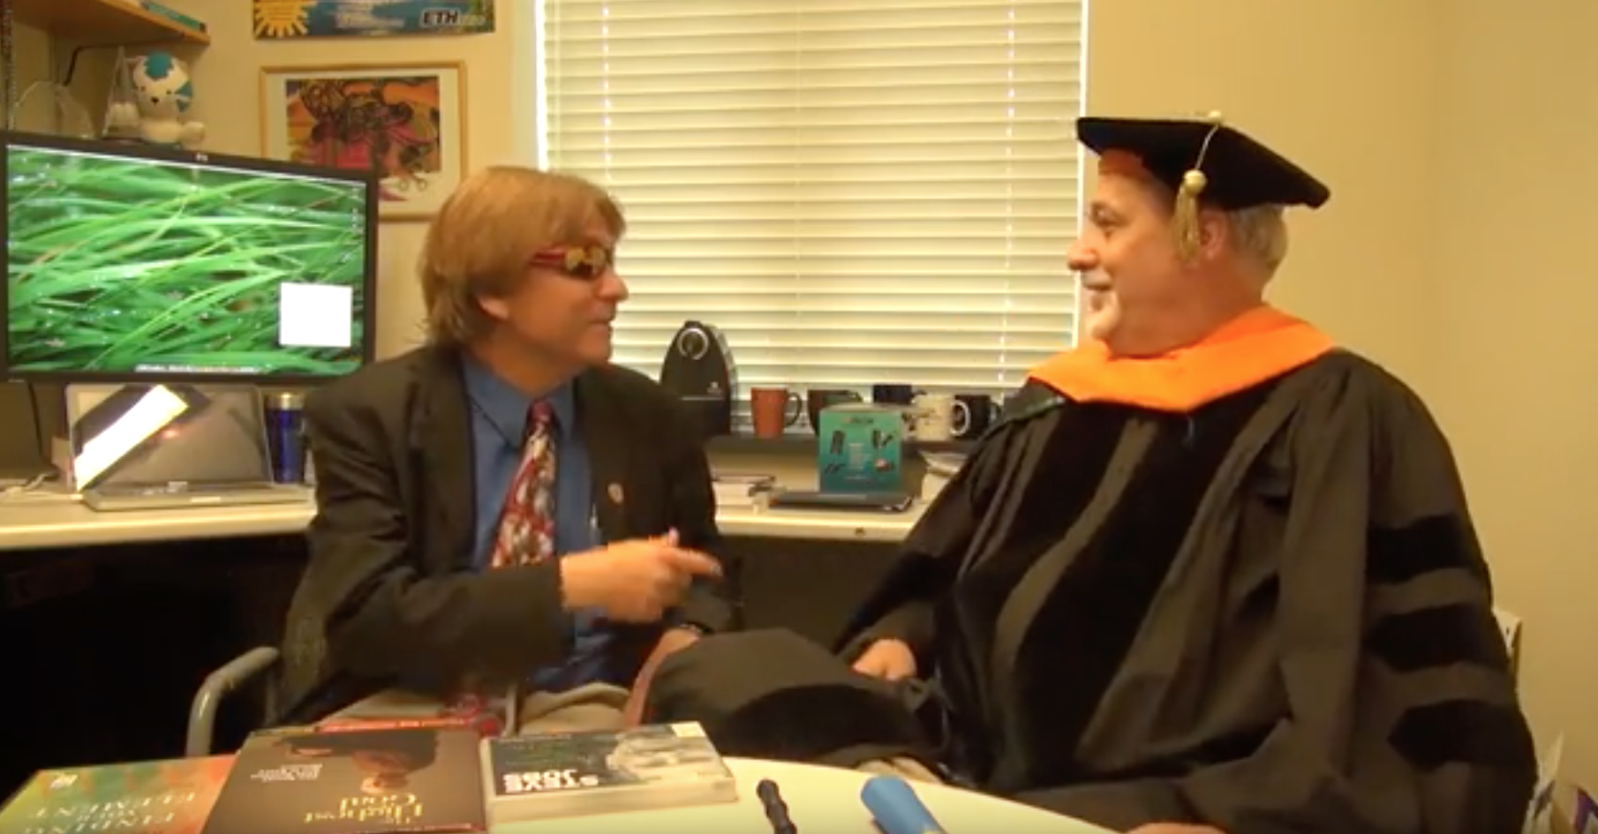
https://www.youtube.com/watch?v=SfQYA0JQWkA

Slide 33
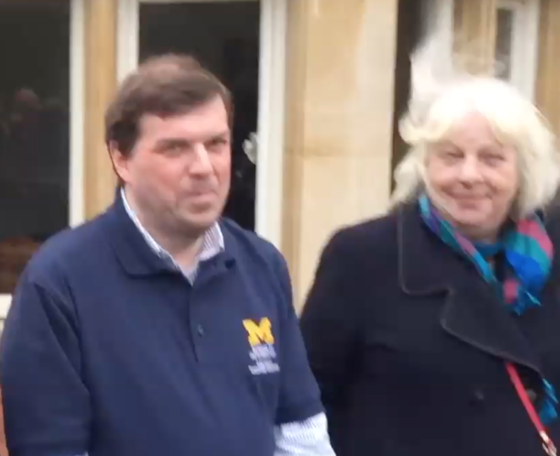
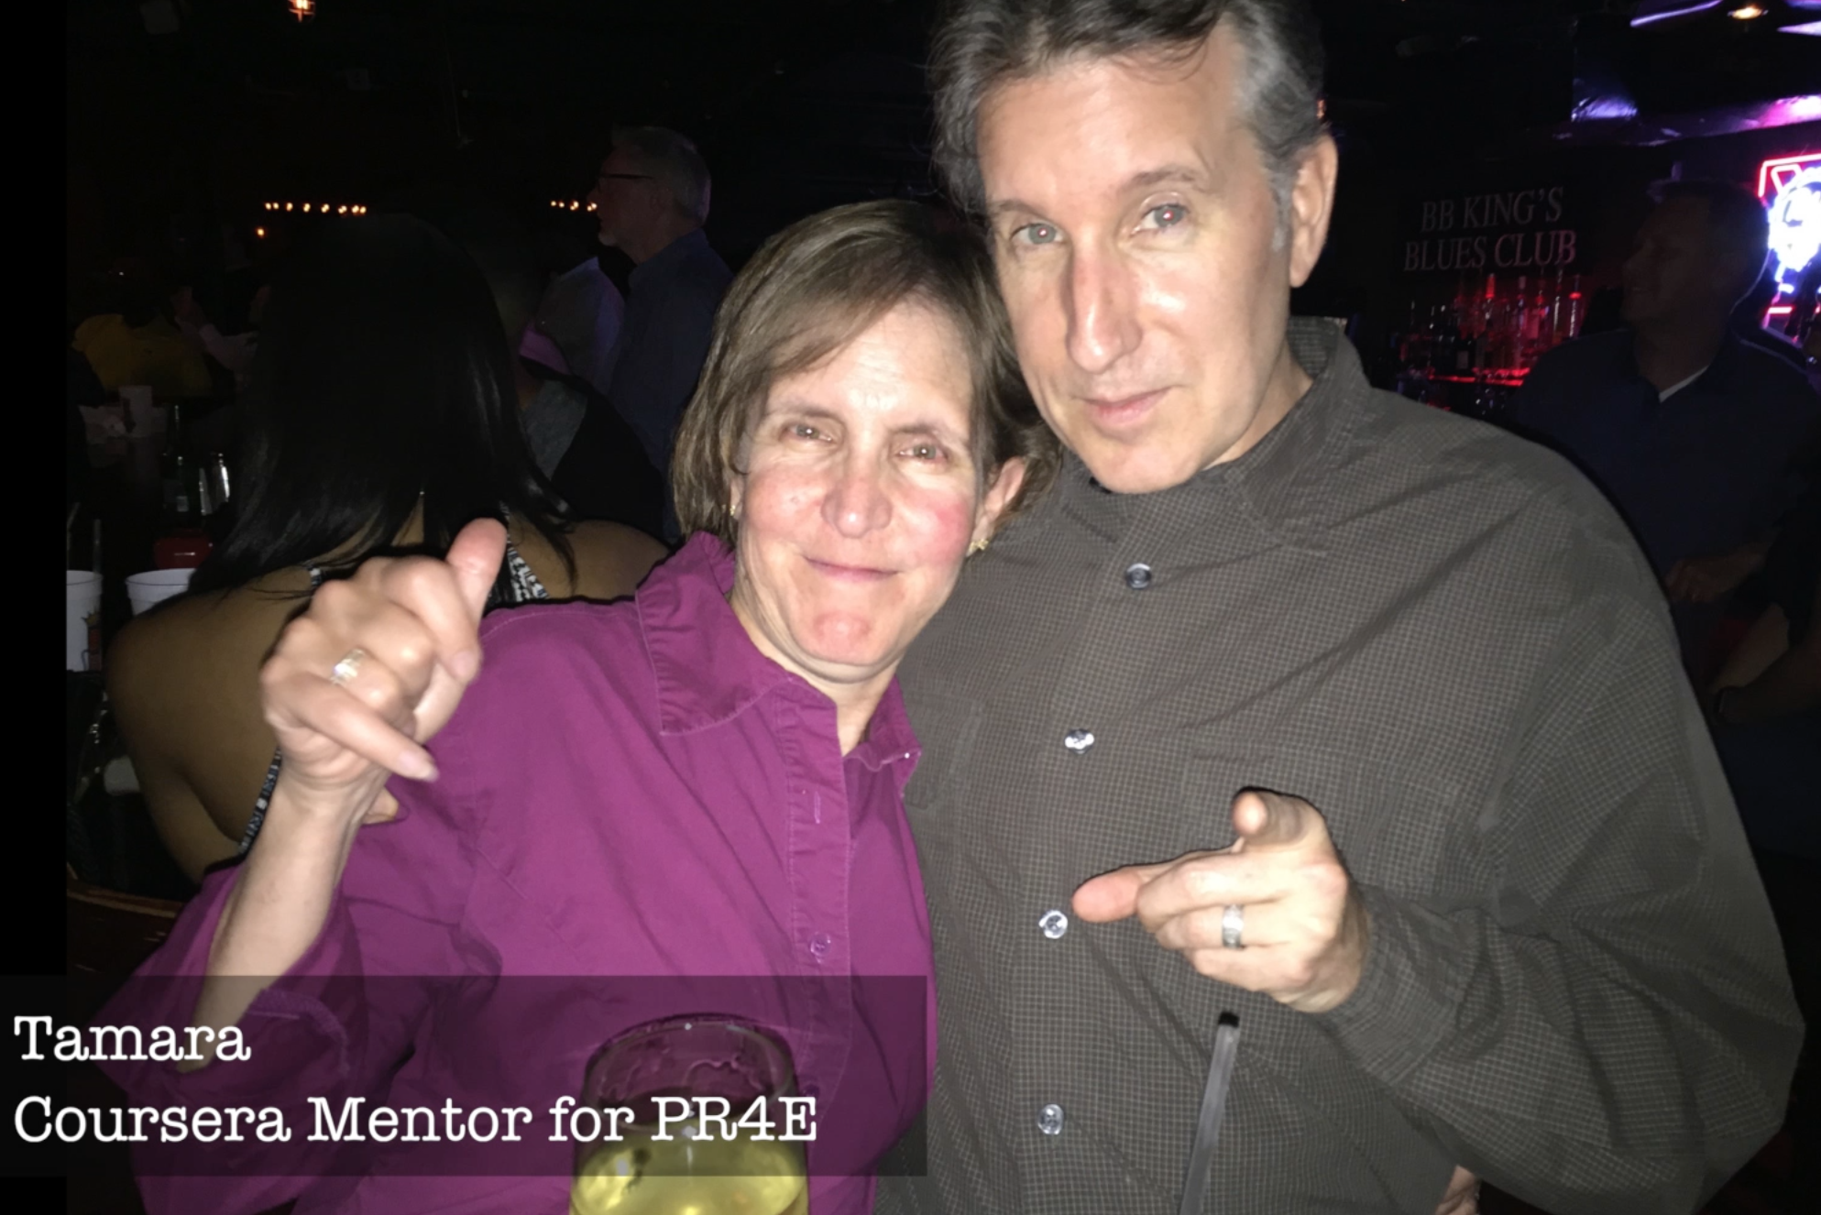
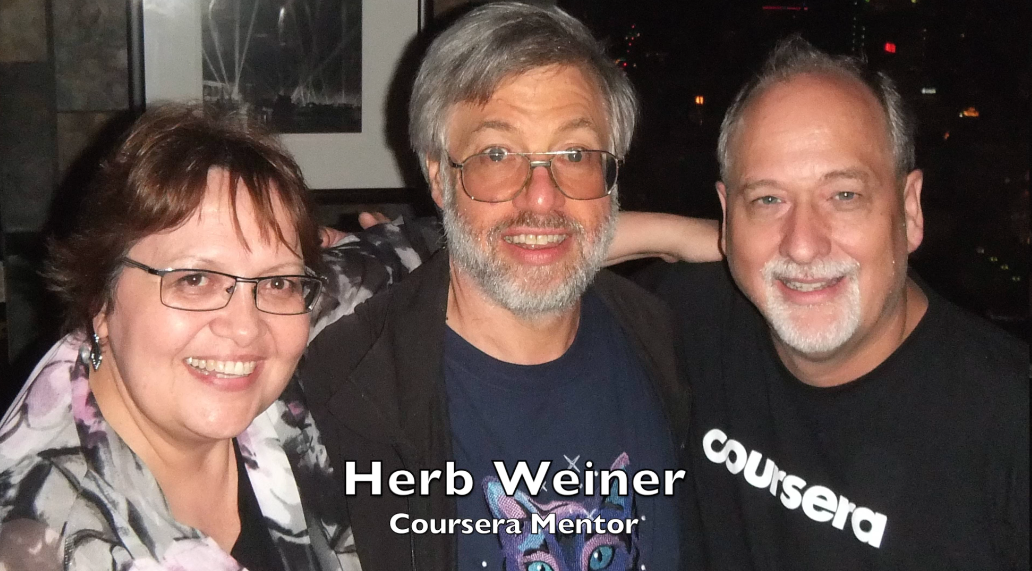
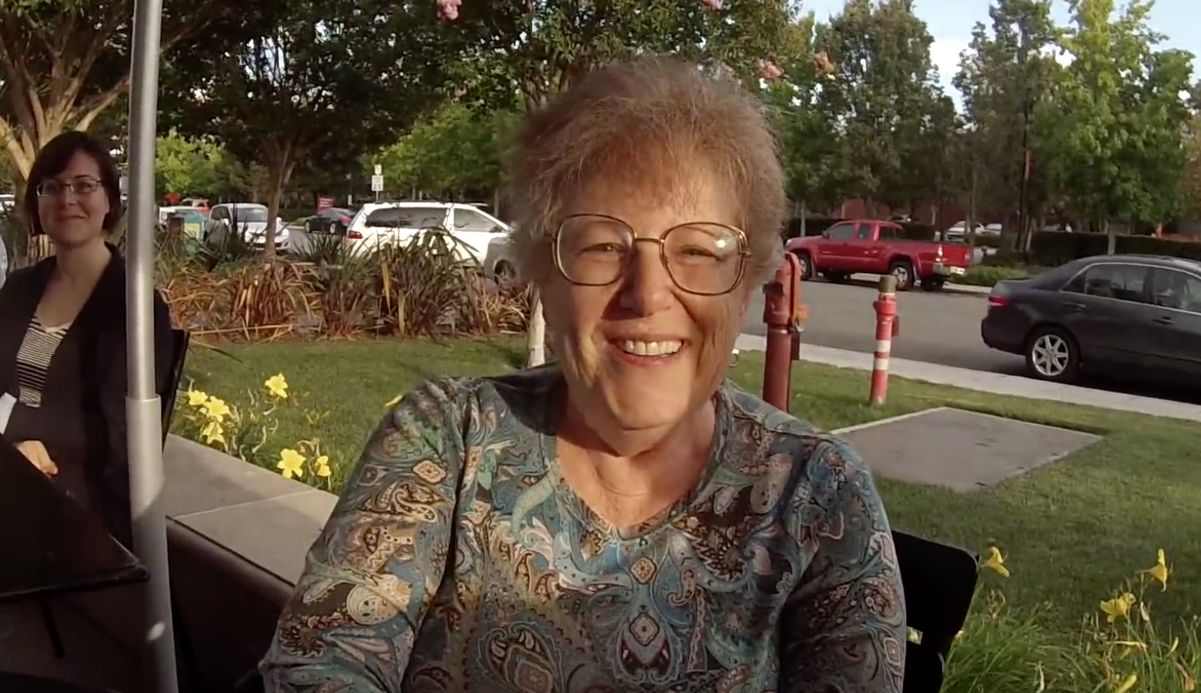
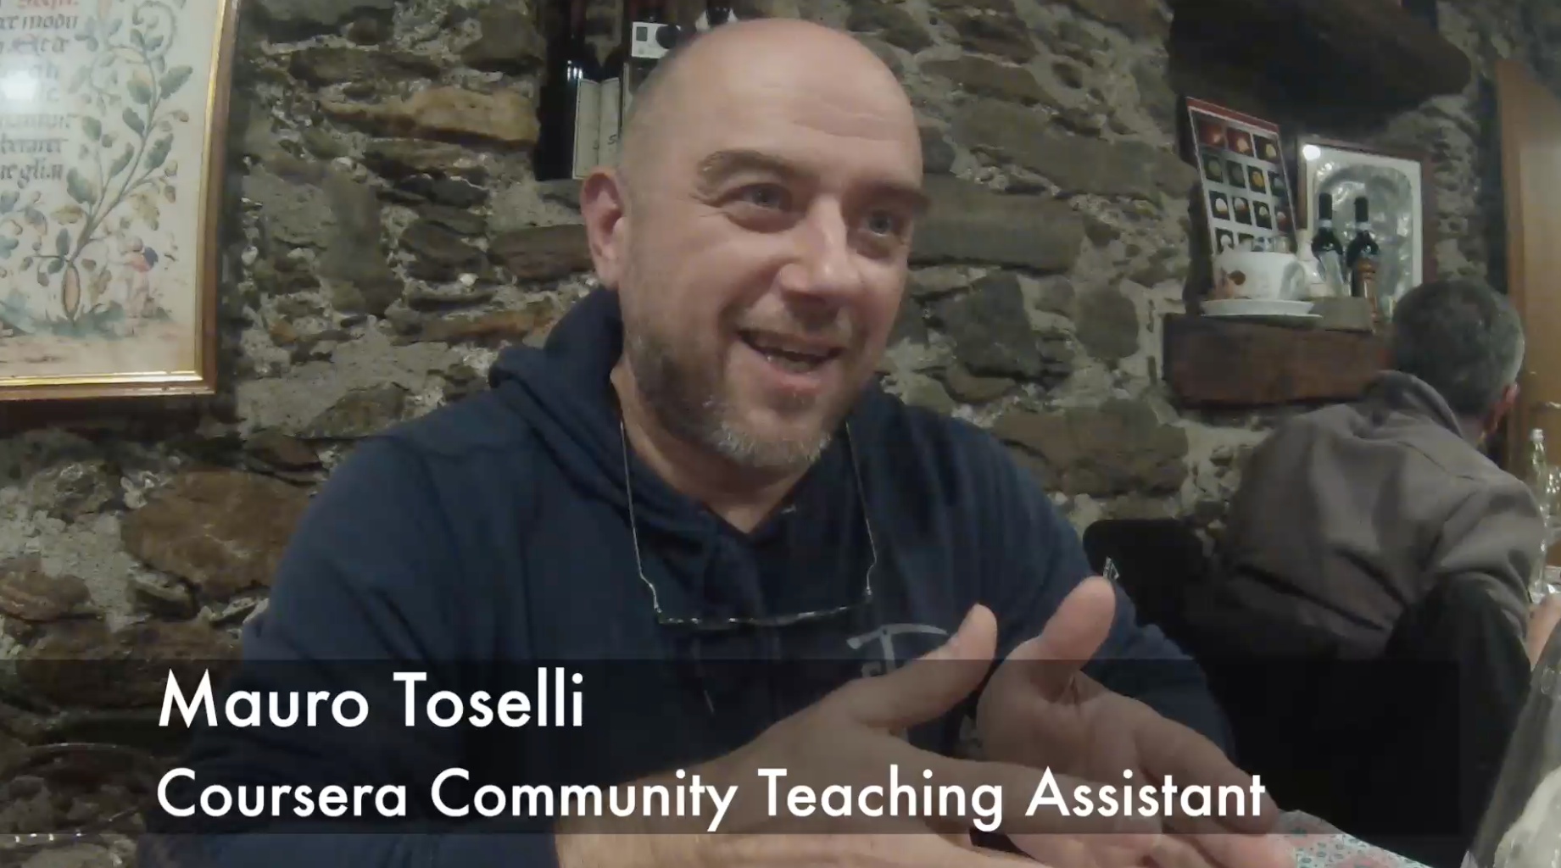

Slide 34
New York, Los Angeles, Ann Arbor, Chicago, Washington DC, Memphis, Seattle, Seoul, Barcelona, London, Mexico City, Amsterdam, Manila Melbourne, Perth...
http://office-hours.dr-chuck.com
Notes:
Since I have a very active travel schedule, I decided to hold office hours in the major cities I have visited. I have held office hours in over 40cities and in each location somewhere between two and 15 students show up.

Slide 35
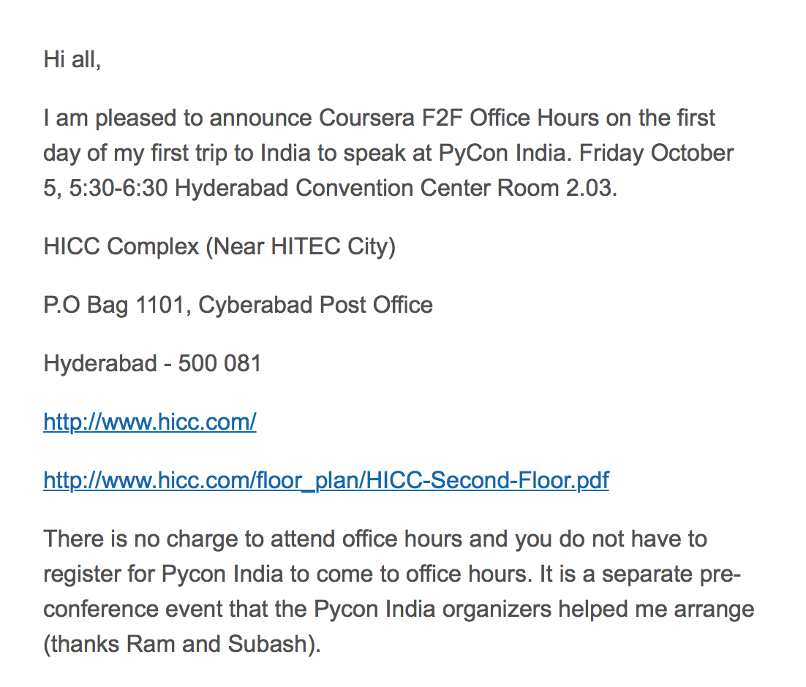

Slide 36
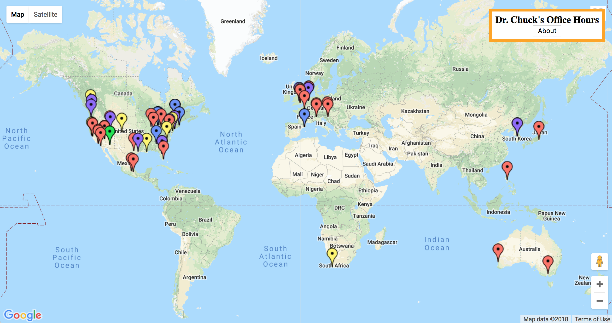
www.dr-chuck.com/office

Slide 37
Roadmap
Research: Create the first standards based application store for education
www.tsugi.org
www.tsugicloud.org
www.learnxp.com
Teaching: Build More Coursera Specializations (with 100% OER materials)
Django for Everybody
Computer Architecture for Everybody
C Programming for Everybody

Slide 38
Questions / URLs…
EdTech Tools
www.tsugi.org
www.tsugicloud.org
www.learnxp.com
Coursera MOOCs
Python for Everybody
Web Design for Everybody (Colleen)
Web Applications for Everybody
Free MOOCs / CC Materials
www.wa4e.com
www.py4e.com
www.wd4e.com (Colleen van Lent)
Twitter: @drchuck

